Slide 1
Open Pyrojet – Graphical Assembly Manual
By Michael Thomas Lynn
maydraal@gmail.com

Slide 2
Things we will need to get started:
• A desktop CNC router(I use the Genmitsu 3018 Pro with 0.1mm tip, 10 degree draft single flute router bits), band saw, hack saw, or jewelers saw.
• 2.54mm pitch perfboard, preferably high quality FR4 with nickel plated through vias.
• 1.27mm pitch perfboard, preferably high quality FR4 with nickel plated through vias.
• Alternatively, plain copper clad high quality FR4, less vias.
• A box of M1-M1.4 X 3mm self-tapping black oxide coated screws
• Silicon carbide monofilament, 0.14mm diameter or less, from any supplier. SCS-6(carbon core), goodfellow (tungsten core) or elsewhere will do.
• Basic Multimeter with resistance measuring capabilities between 20K Ohm and 1 Ohm.
• Kapton tape 1” wide or less
• Gorilla glue, or JB weld set clear, 2 part, foam free epoxy, or PMMA super glue
• 2.54 mm pitch male header pins color coded with at least 9 discrete colors.
• 0.015” diameter 32Sn64Pb4Ag flux core solder
• Fine tip 0.3-0.6mm diameter 10 degree draft, soldering iron tip(I find this to be easiest for me)
• Soldering iron
• Precision screw driver set, with fine point flat head, and fine point Phillips bits
• A flat and level work surface
• A good work light and magnifier (microscope camera, eye loop, head visor, soldering magnifier will do)
A hard flat sheet of fine grit sandpaper, or aluminum oxide sheet.
A fine tip sharpie.

Slide 3
Things we will need to get started: Links to items
2.54mm perfboard : https://www.digikey.com/en/products/detail/bud-industries/EXN-23402-PCB/5886452
1.27mm perfboard : https://www.amazon.com/6x8CM-Double-Prototype-Perforated-Through/dp/B01LZA2UJZ
M1 self tapping screws :
https://www.amazon.com/Suit-JERLITU-Phillips-Multi-Purpose-Assortment-Self-Tapping/dp/B08V56GVR2/ref=sr_1_3?crid=29AXFL3H6JDX8&keywords=m1+phillips+head+micro+screws+self+tapping+wood+screws&qid=1645933611&s=industrial&sprefix=m1+phillips+head+micro+screws+self+tapping+wood+screw%2Caps%2C138&sr=1-3-catcorr
Silicon carbide Monofilament : https://www.specmaterials.com/silicon-carbide-fiber-product-price-list
https://www.goodfellow.com/us/en-us/displayitemdetails/p/si67-mt-000120/silicon-carbide-monofilament

Slide 4
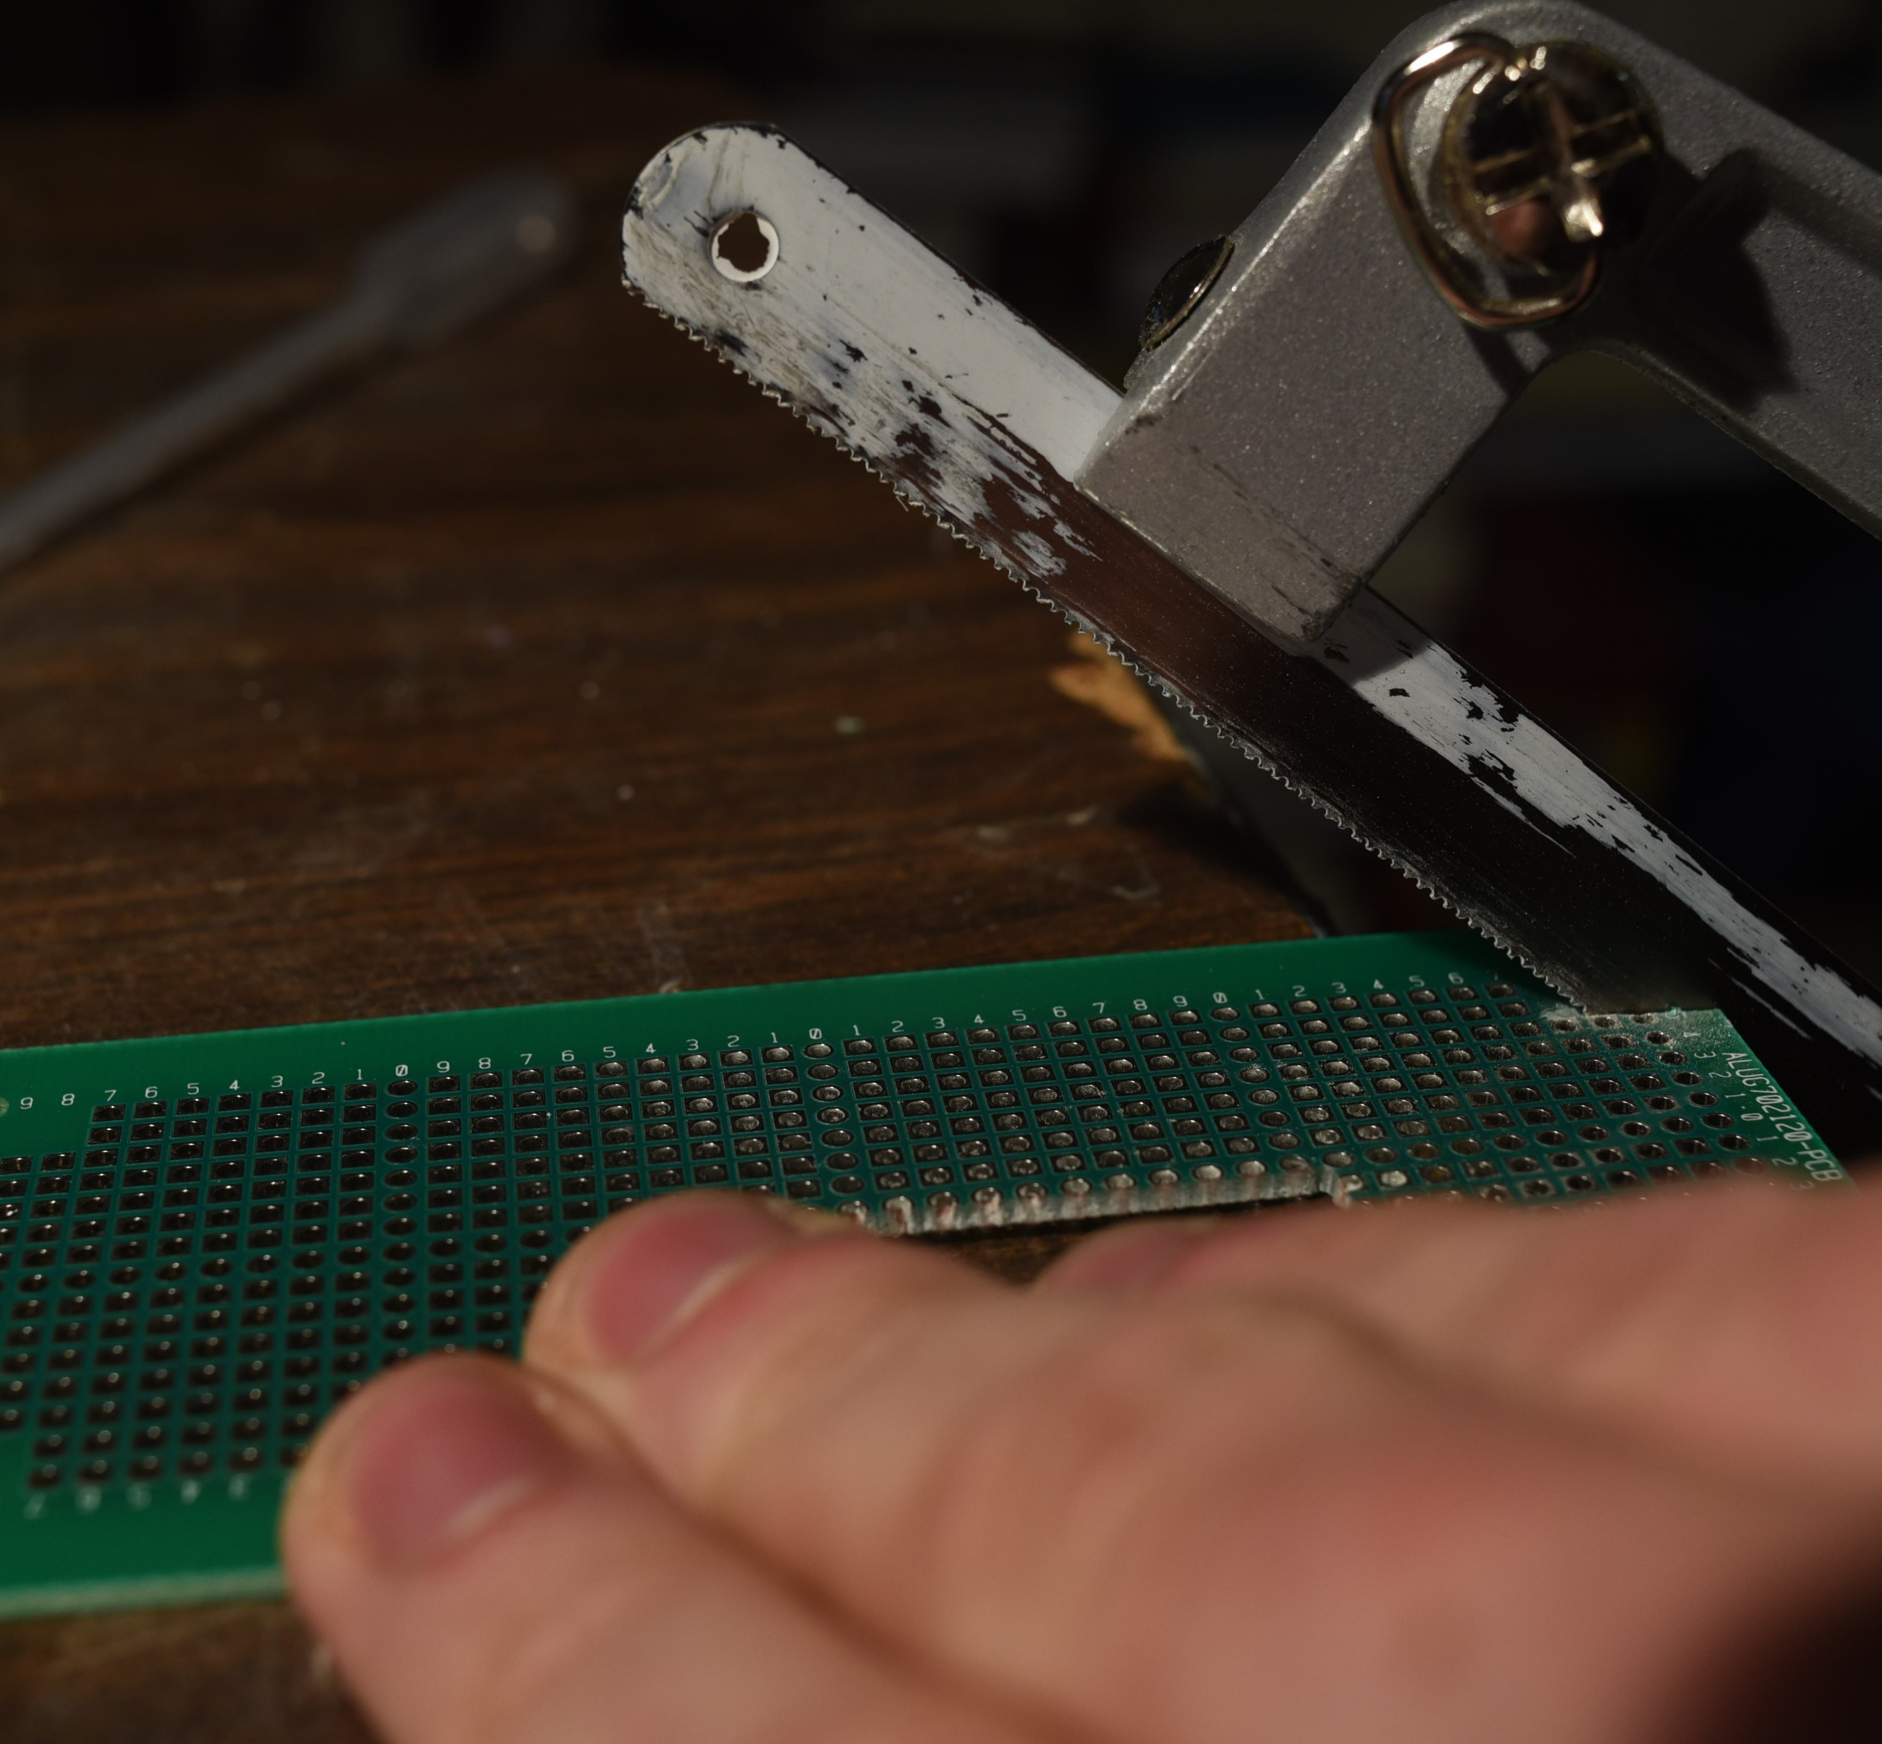
Preparing the Backplane
Lenox Hack Saw with medium metal blade
1.Mill/saw out a rectangular piece of the 2.54mm perfboard, 11 holes long, by 5 holes wide. Approximately, 29 mm long, by 15 mm wide. Try to keep your cuts as straight as possible.
2.54mm pitch FR4 perfboard

Slide 5
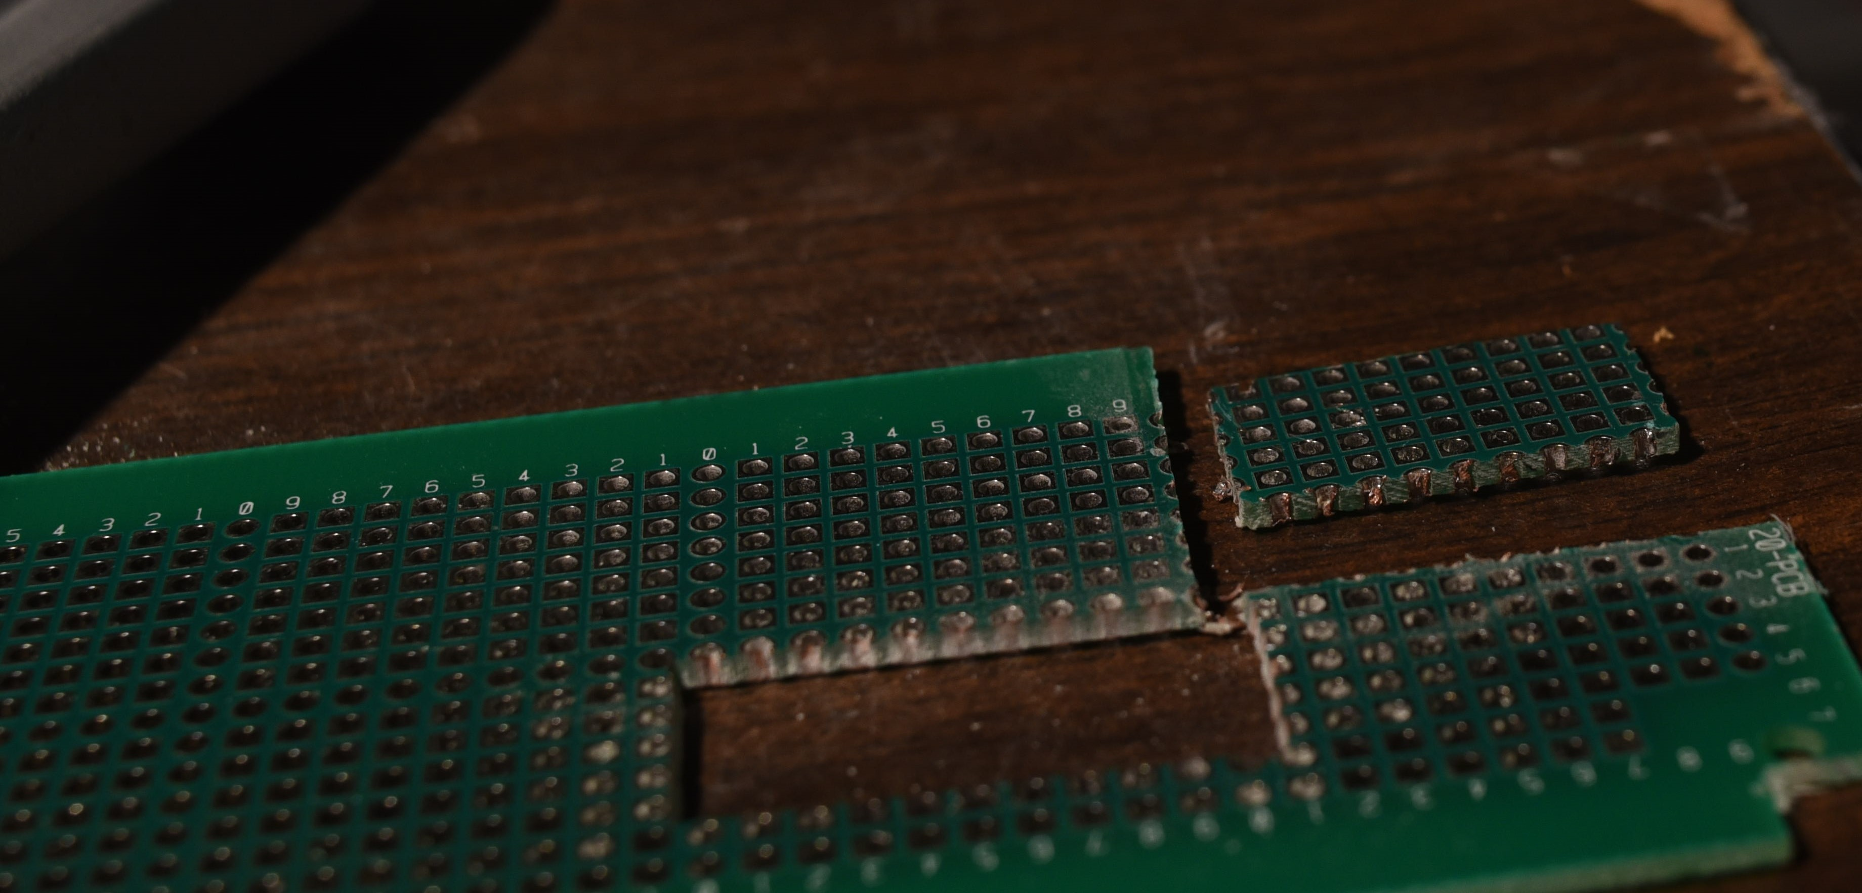
Preparing the Backplane
1.Mill/saw out a rectangular piece of the 2.54mm perfboard, 11 holes long, by 5 holes wide. Approximately, 29 mm long, by 15 mm wide. Try to keep your cuts as straight as possible.
29mmX15mm cut piece
2.54mm pitch FR4 perfboard

Slide 6
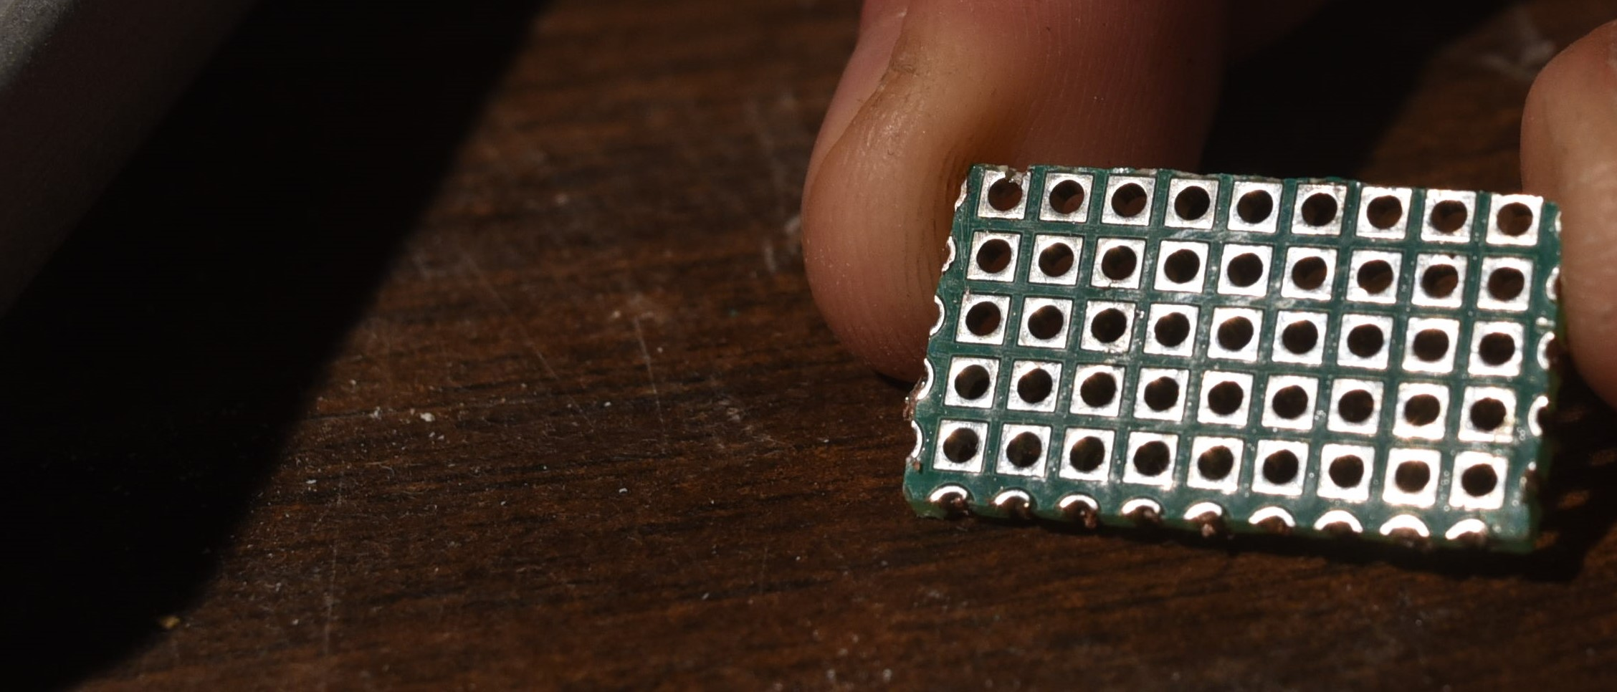
Preparing the Backplane
1.Mill/saw out a rectangular piece of the 2.54mm perfboard, 11 holes long, by 5 holes wide. Approximately, 29 mm long, by 15 mm wide. Try to keep your cuts as straight as possible.
29mmX15mm “Backplane”
Electrical contacts/inkfeed holes we will use

Slide 7
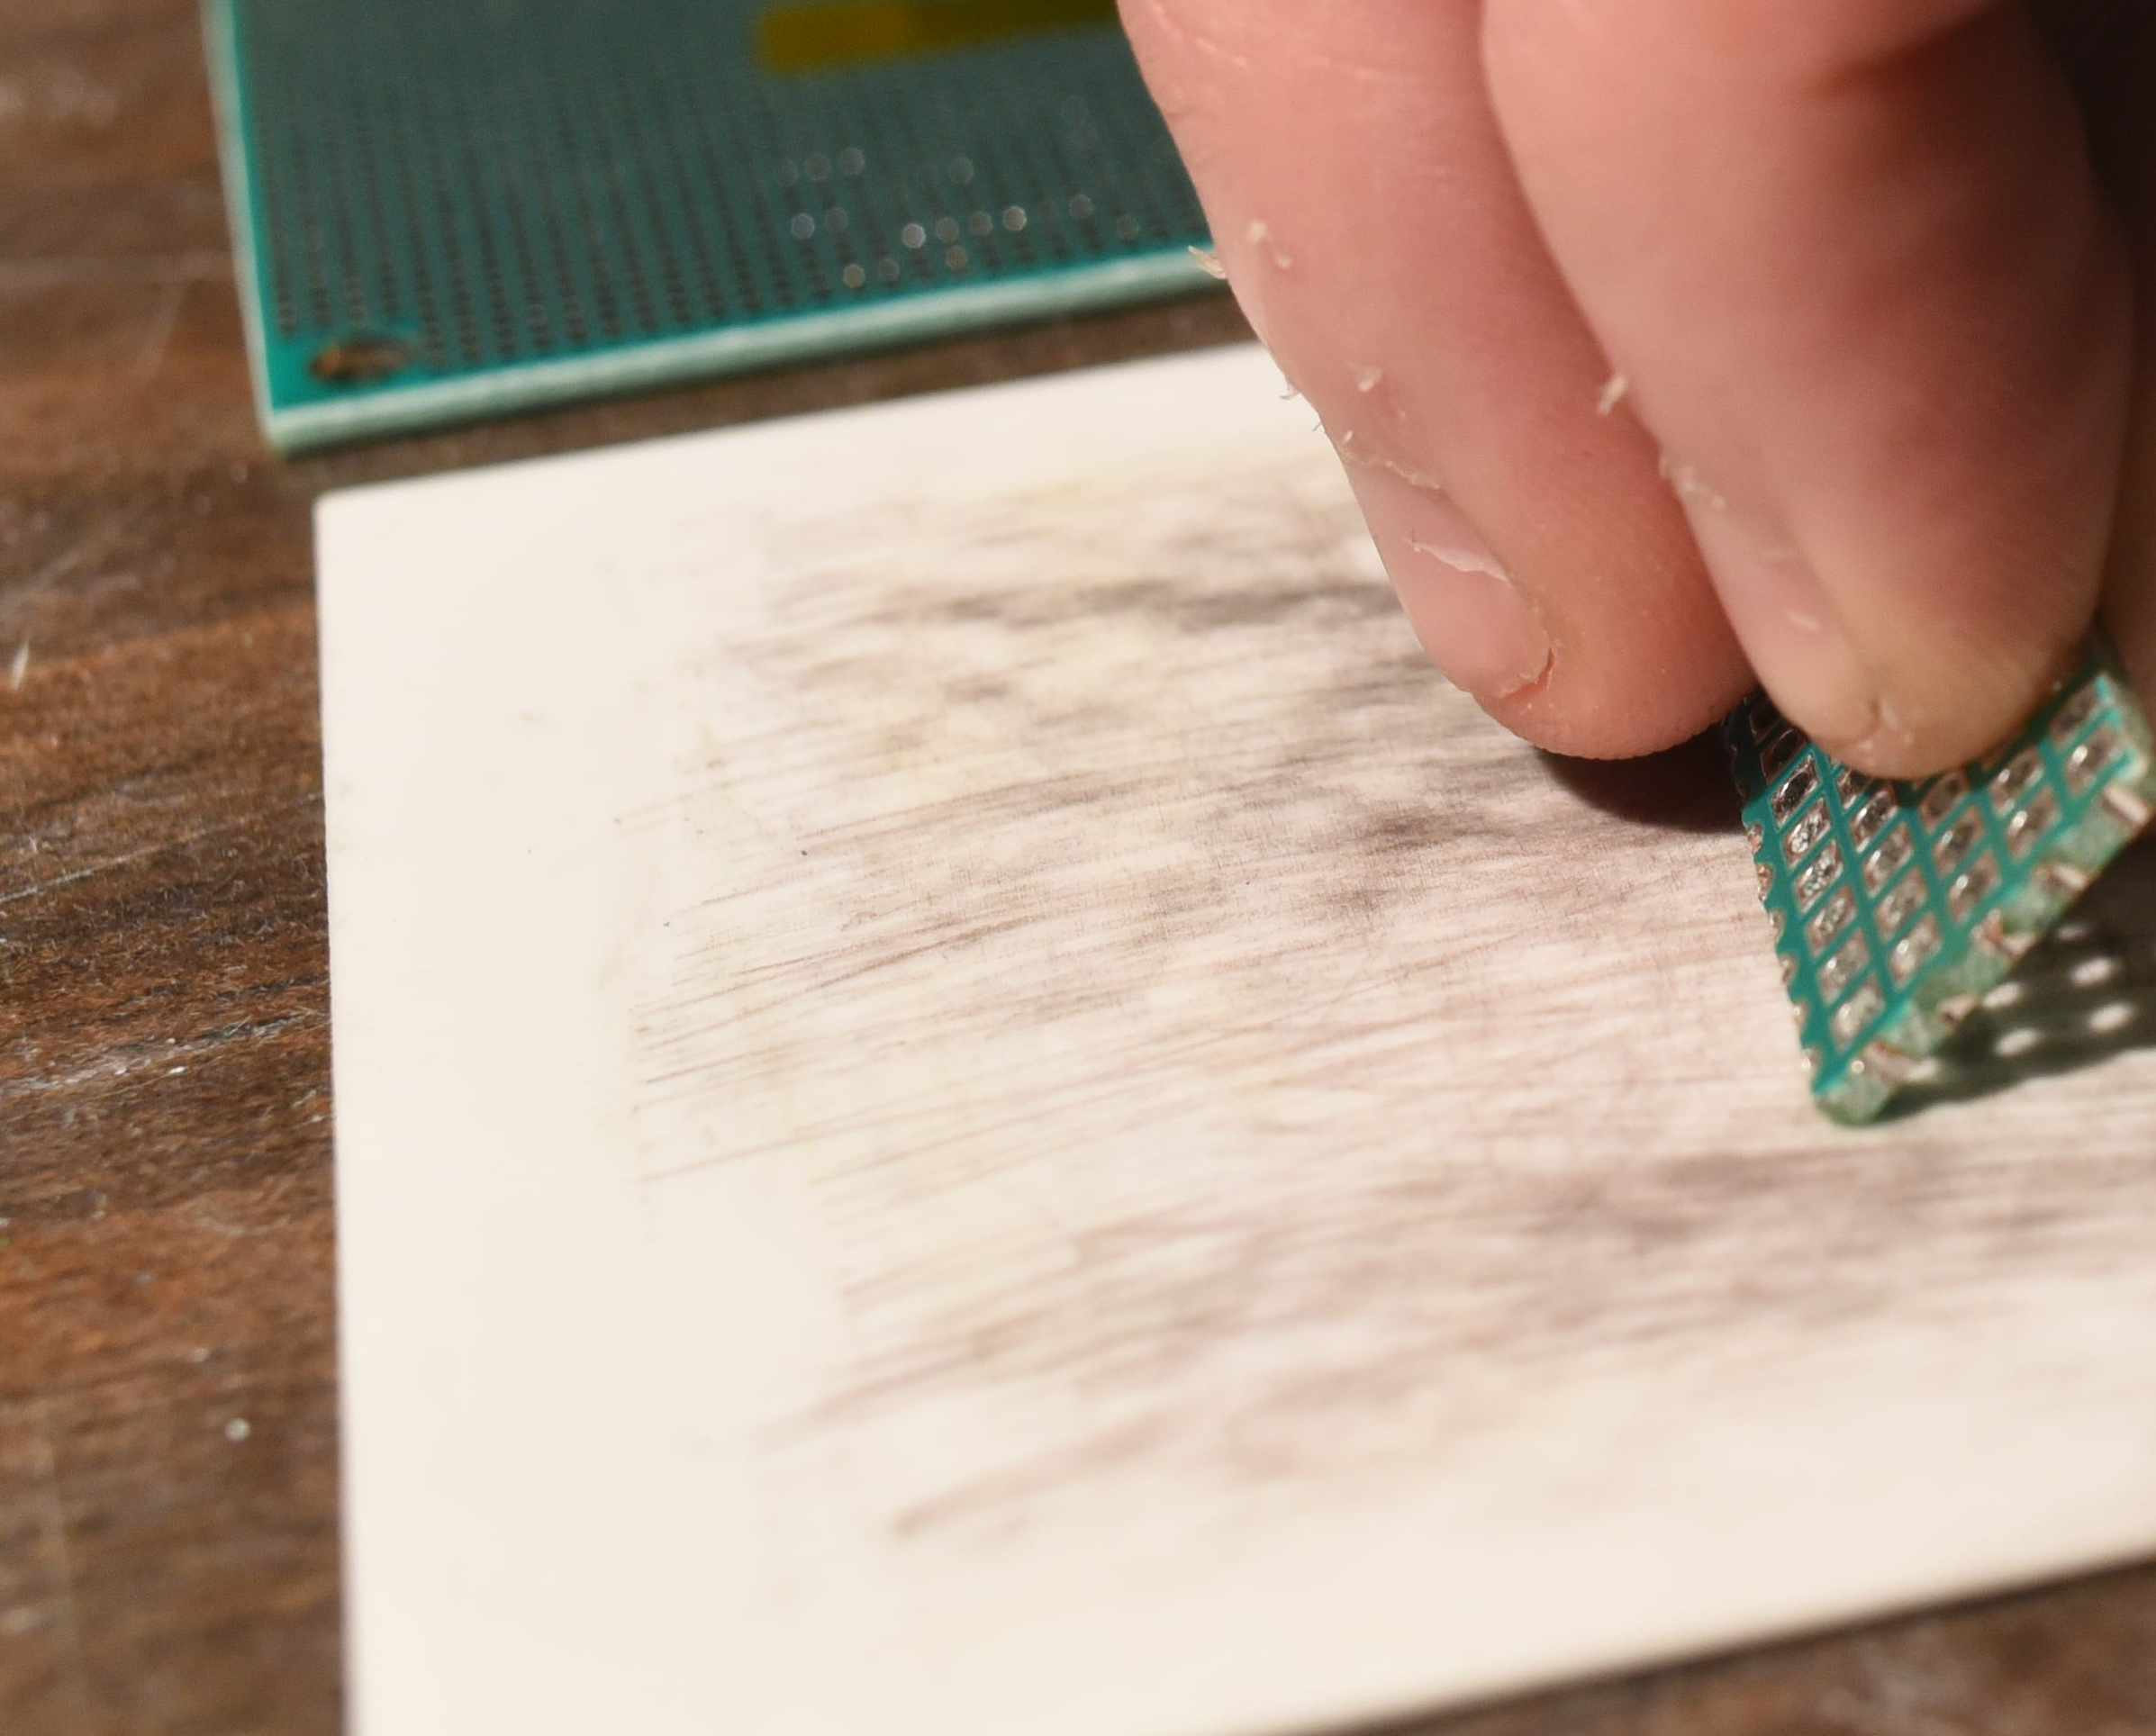
Preparing the Backplane
2. Lap the rough cut edges of the back plane to make sure it will fit nicely on the nozzle plate. Be sure to dunk the backplane 99% IPA or a similar cleaning agent to remove dust and oil after lapping.
Al2O3 sheet for lapping
Backplane having it’s edges lapped smooth.

Slide 8
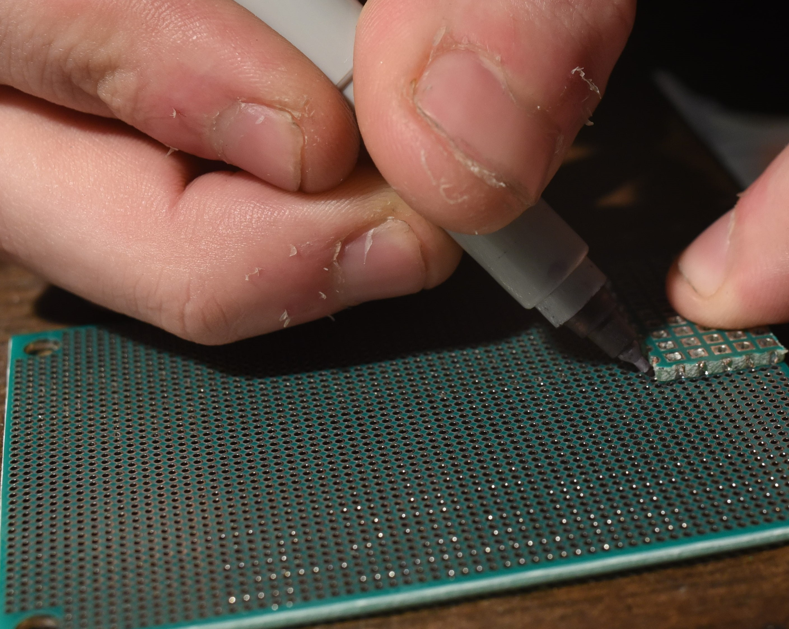
Preparing the nozzle plate
3. Place the freshly cut, lapped and cleaned backplane onto the 1.27mm pitch perfboard, aligning the holes of each board.
Mark the position with a fine point sharpie, and mark the location of the heater row on the nozzle plate as well.
Fine point sharpie
Backplane
Heater Row
1.27mm pitch perfboard (for nozzle plate)

Slide 9
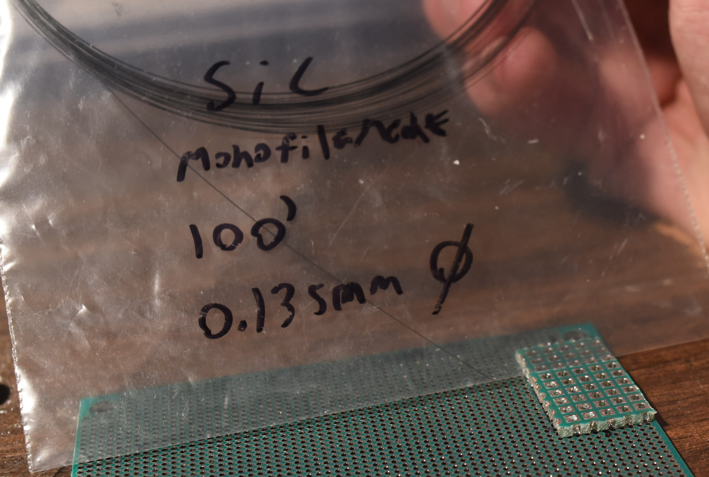
Installing the heating element
4. Find your silicon carbide monofilament heating element of choice. Mine is a specialty materials, SCS-6 standard 0.135mm carbon core 3C, beta, silicon carbide CVD derived monofilament.
Backplane
1.27mm pitch perfboard (for nozzle plate)

Slide 10
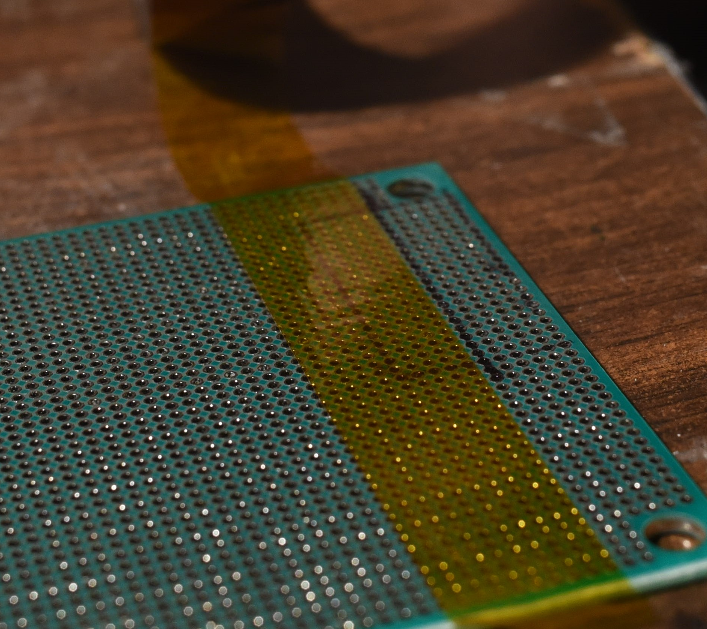
Installing the heating element
5. Just above where you made your heater row mark, place a piece of Kapton tape, being careful not to cover the row of holes in the 1.27mm perfboard where your heater row goes.
Heater Row
Kapton Tape
1.27mm pitch perfboard (for nozzle plate)

Slide 11
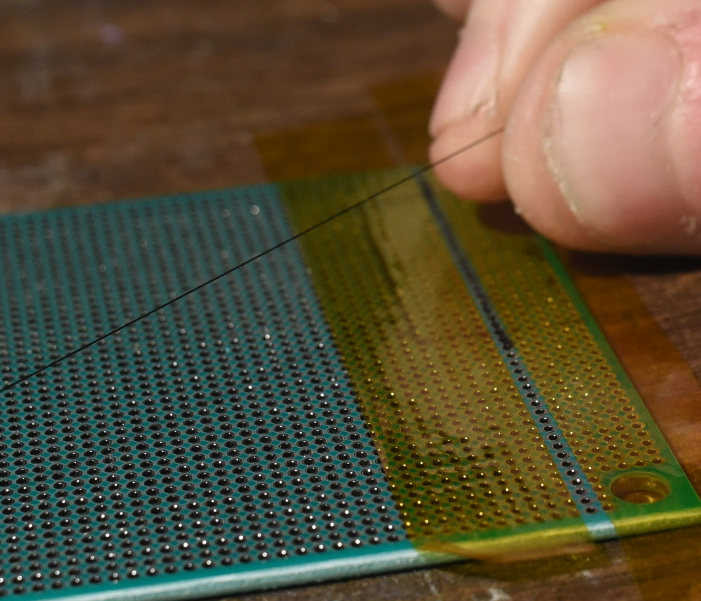
Installing the heating element
6. Place another piece of Kapton along the bottom edge of the 1.27mm perfboard, just below your heater row mark as shown, to secure the nozzle plate to your work surface and provide alignment of the filament as well as preload between the nozzle plate and the backplane.
SiC Filament
Heater Row
Kapton Tape
1.27mm pitch perfboard (for nozzle plate)

Slide 12
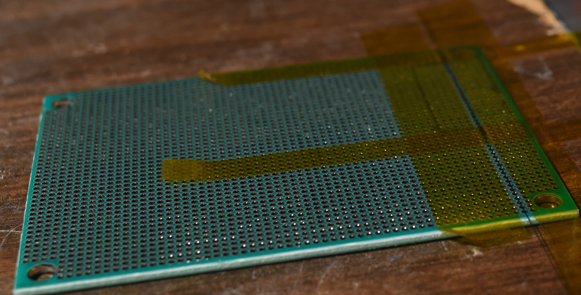
Installing the heating element
7. Lay the silicon carbide monofilament along the heater row as shown, between the pieces of Kapton tape.
Kapton Tape
SiC Filament
1.27mm pitch perfboard (for nozzle plate)

Slide 13
Installing the heating element
8. Secure the filament to the 1.27mm pitch perfboard nozzle plate and across the heater row with Kapton tape, perpendicular to the other two pieces of Kapton as shown.
Kapton Tape
SiC Filament
1.27mm pitch perfboard (for nozzle plate)

Slide 14
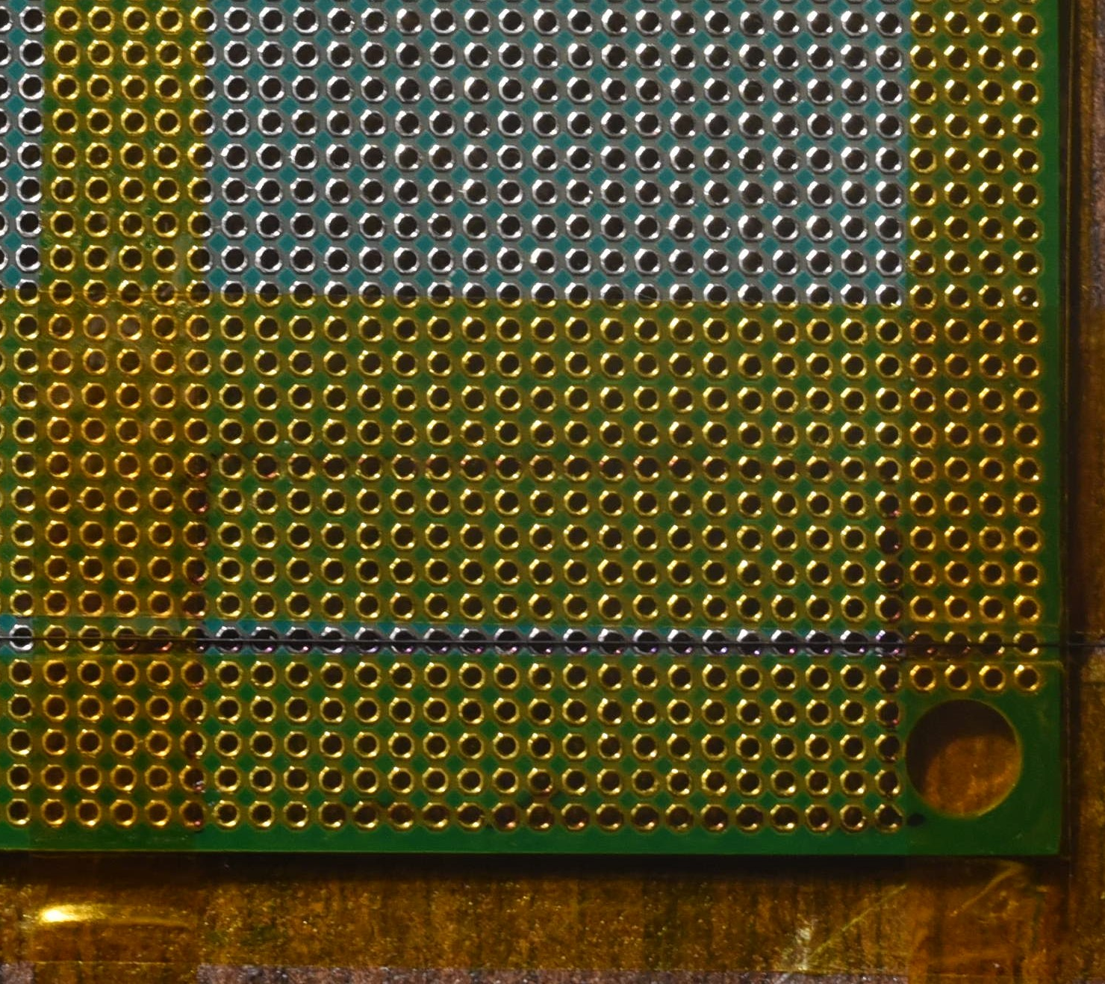
Installing the heating element
8. Secure the filament to the 1.27mm pitch perfboard nozzle plate and across the heater row with Kapton tape, perpendicular to the other two pieces of Kapton as shown.
Kapton Tape
SiC Filament
1.27mm pitch perfboard (for nozzle plate)

Slide 15
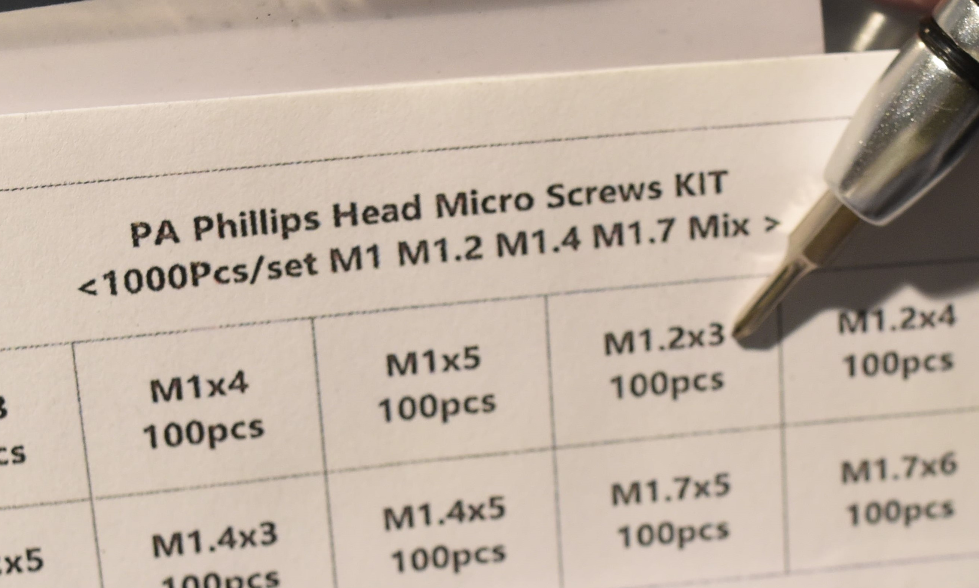
Installing the backplane
Backplane fasteners
9. Find your m1.2X3mm self tapping screws and precision screw driver…

Slide 16
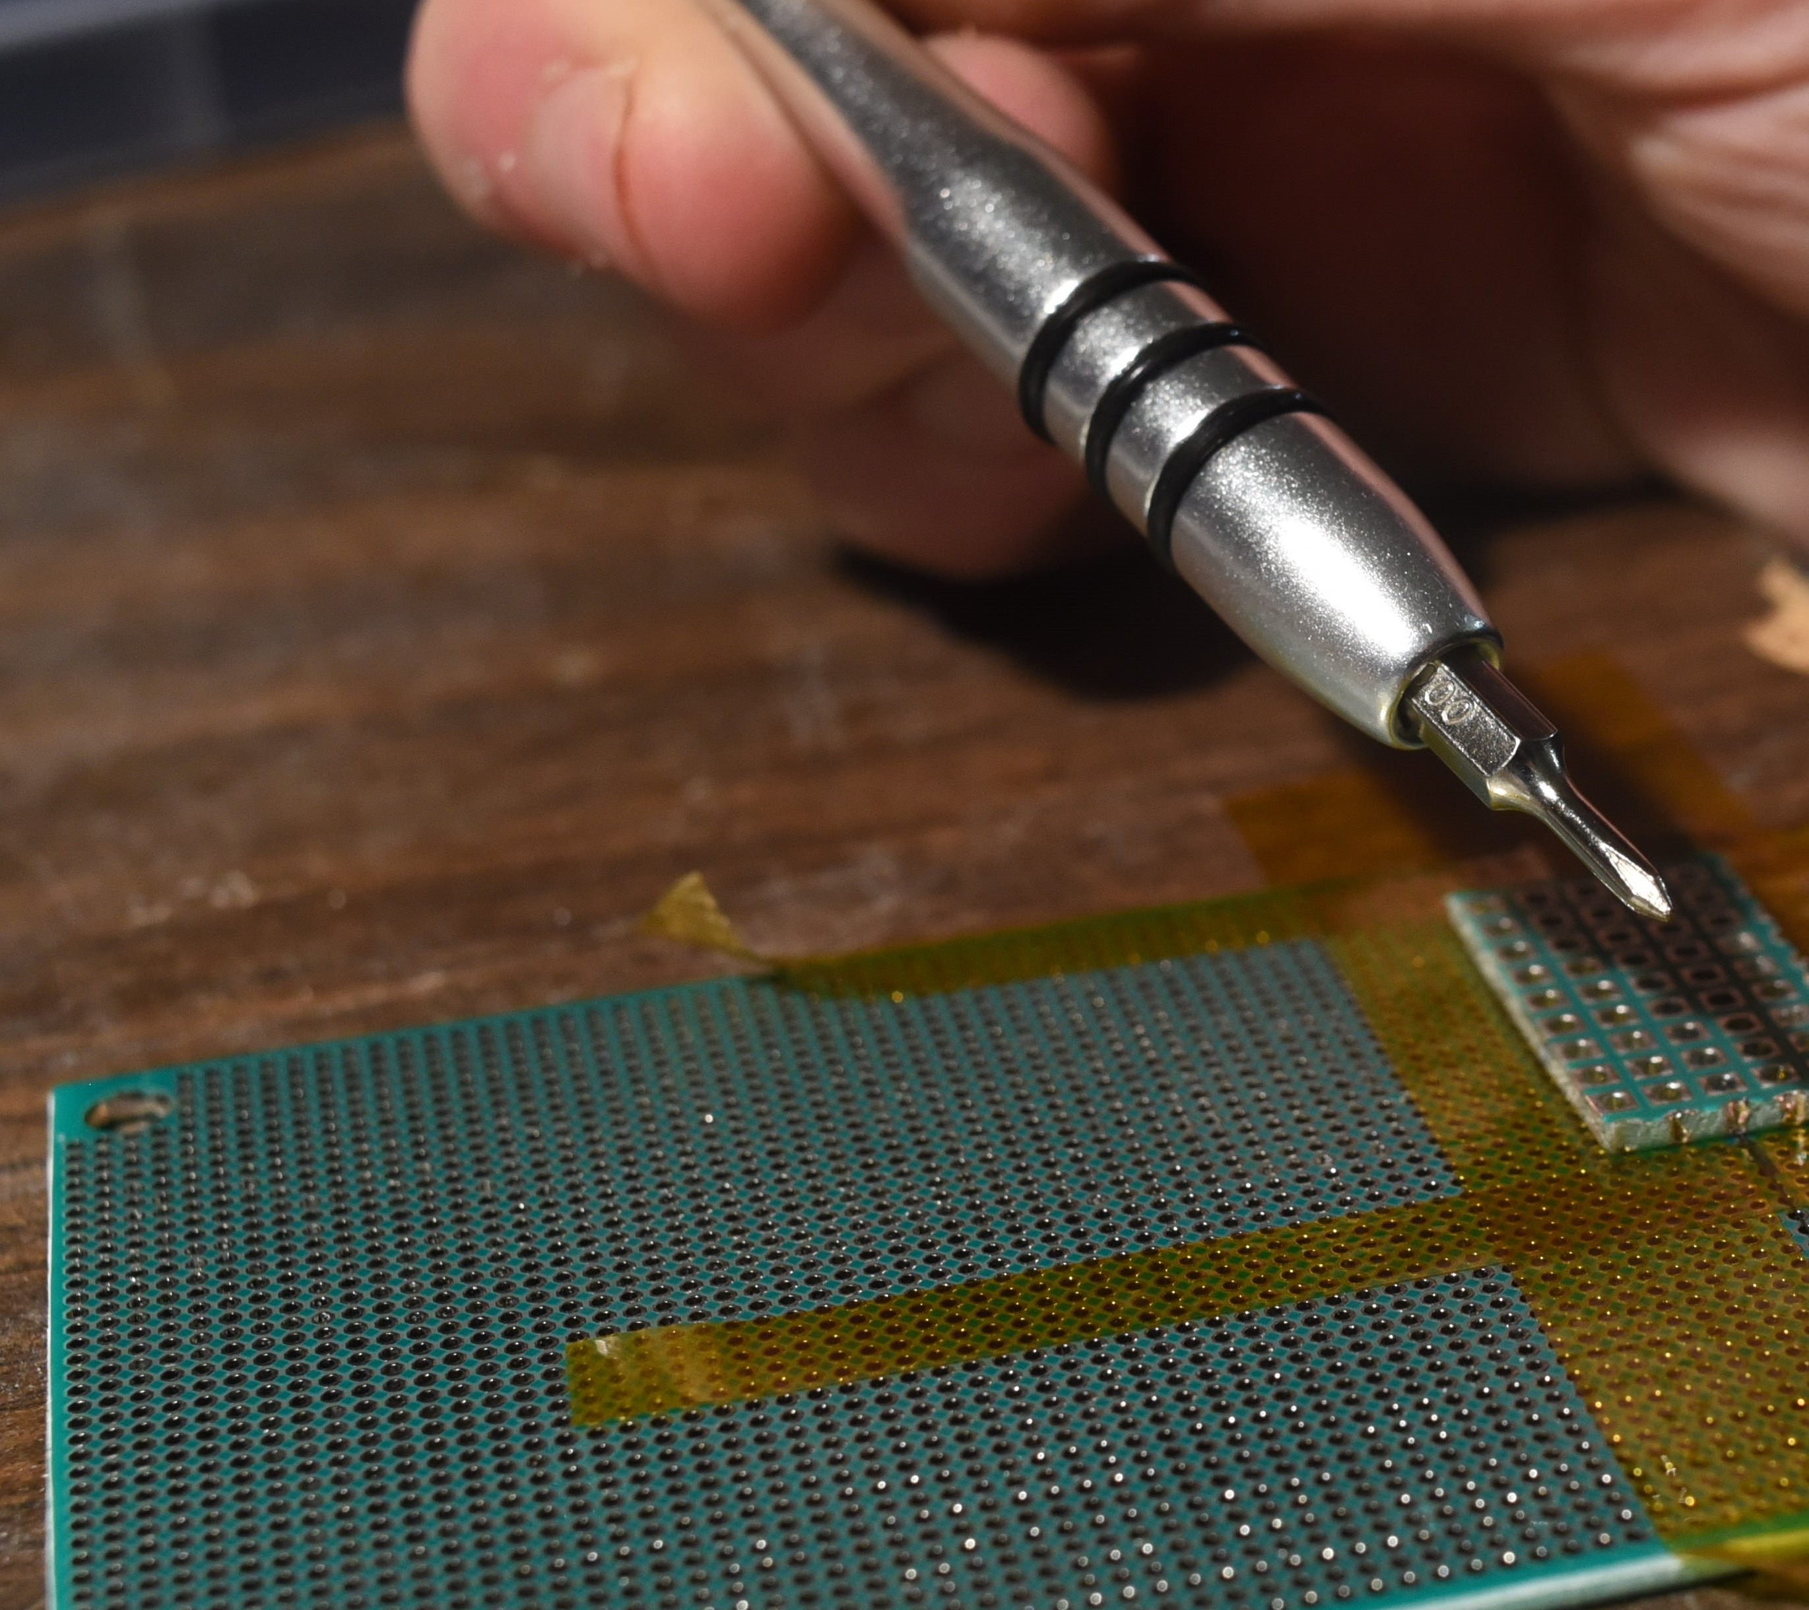
Installing the backplane
Precision Philips screws driver magnetic bit
9. Find your m1.2X3mm self tapping screws and precision screw driver…
Back plane laid on top of the secured SiC fiber and nozzle plate
1.27mm perfboard for nozzle plate

Slide 17
Installing the backplane
10. Lay your backplane gently across your now tapped down silicon carbide monofilament heating element, being sure to align every other hole in the nozzle plate, with each hole in the backplane, and extract a m1.2 X 3mm self tapping screw from the box.

Slide 18
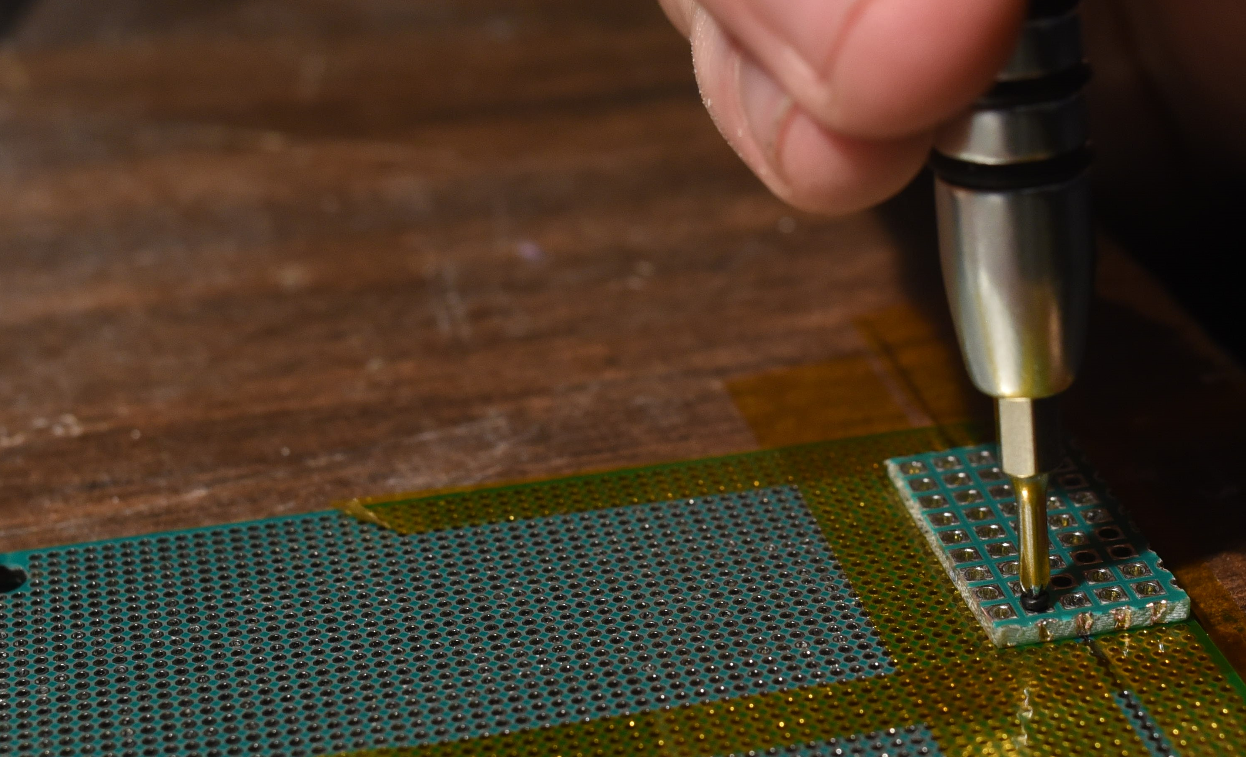
Installing the backplane
11. Firmly press and screw the m1.2 X 3mm screw into one one of the aligned holes, preferable one at the far left corner of the backplane closest to the edge. It should bite and screw in easily. Tighten it until it is firm and snug, and resists further turning. But no tighter.
Precision screw driver
SiC fiber
Backplane
M1.2X3mm screw
1.27mm perfboard for nozzle plate

Slide 19
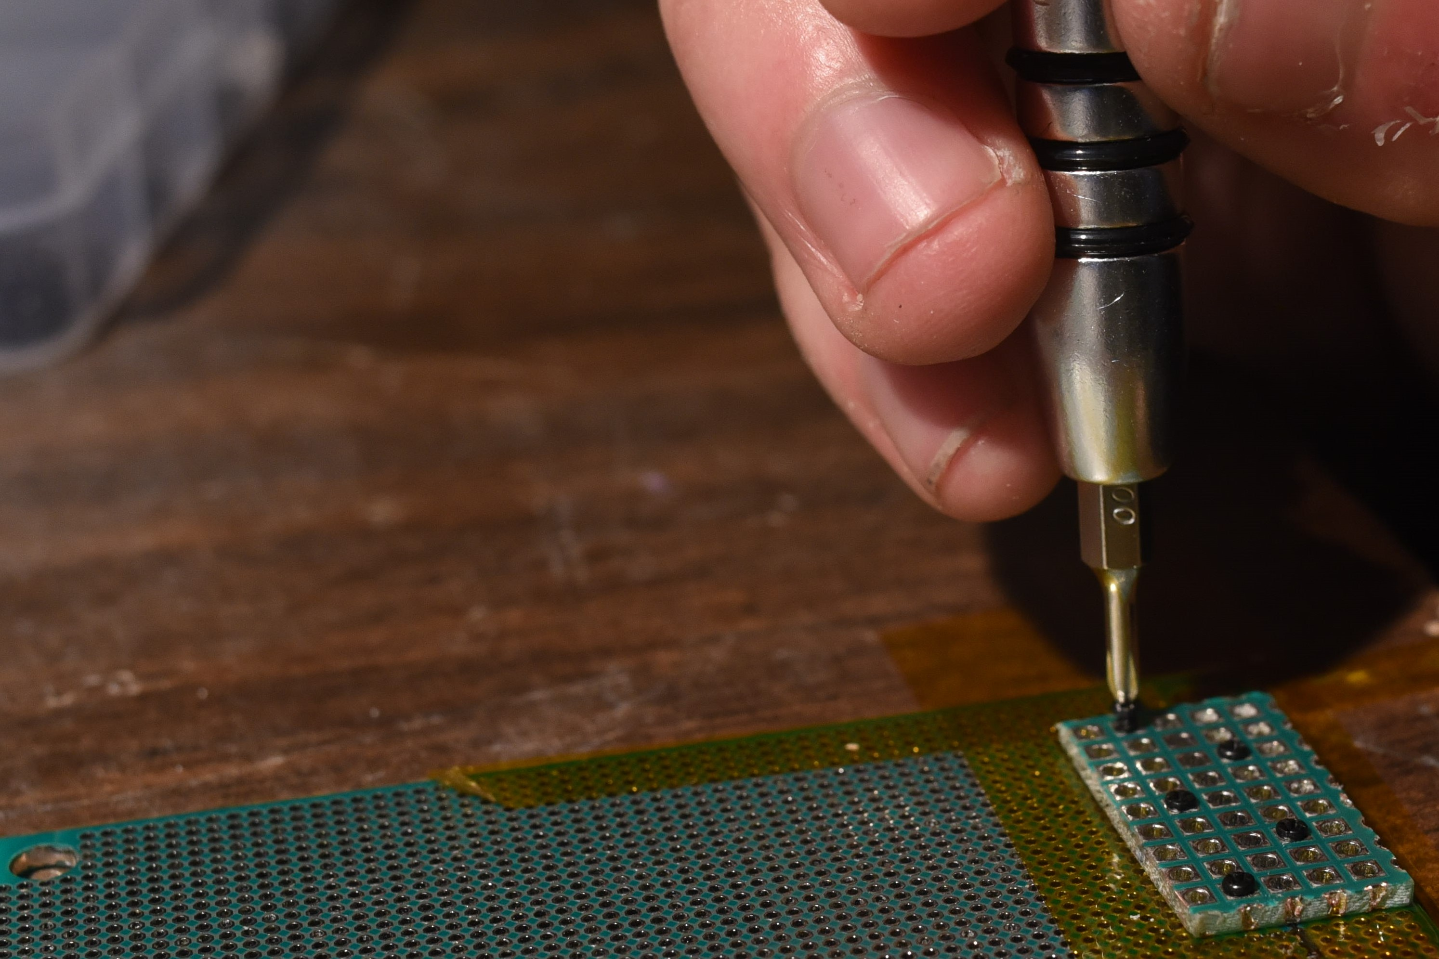
Installing the backplane
12. Repeat this fastening process, being careful to stagger the screws and install them adjacent to the heater row, so that no two are on the same column. This will make soldering easier later, and ensures a uniform clamping force on the heating element which provide consistent electrical and thermal contact.
Precision screw driver
2.54 mm perfboard Backplane
Staggered M1.2X3mm screws
1.27mm perfboard for nozzle plate

Slide 20
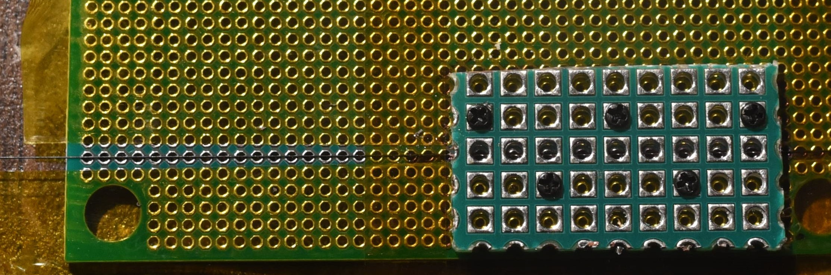
Installing the backplane
1.27mm perfboard for nozzle plate
12. Repeat this fastening process, being careful to stagger the screws so that no two are on the same column. This will make soldering easier later, and ensures a uniform clamping force on the heating element which provide consistent electrical and thermal contact.
2.54 mm perfboard Backplane
SiC fiber heater on heater row
Staggered M1.2X3mm screws

Slide 21
Installing the backplane
Line to probe along…
13. Set your multimeter to the 200 Ohm setting, and probe each pair of adjacent contacts along the heater row on the now secured backplane.
Go back and tighten the screws until all the heater resistances read between 10 and 100 ohms. If all your screws are tightened evenly, all the resistances should cluster between 20 and 50 ohms.

Slide 22
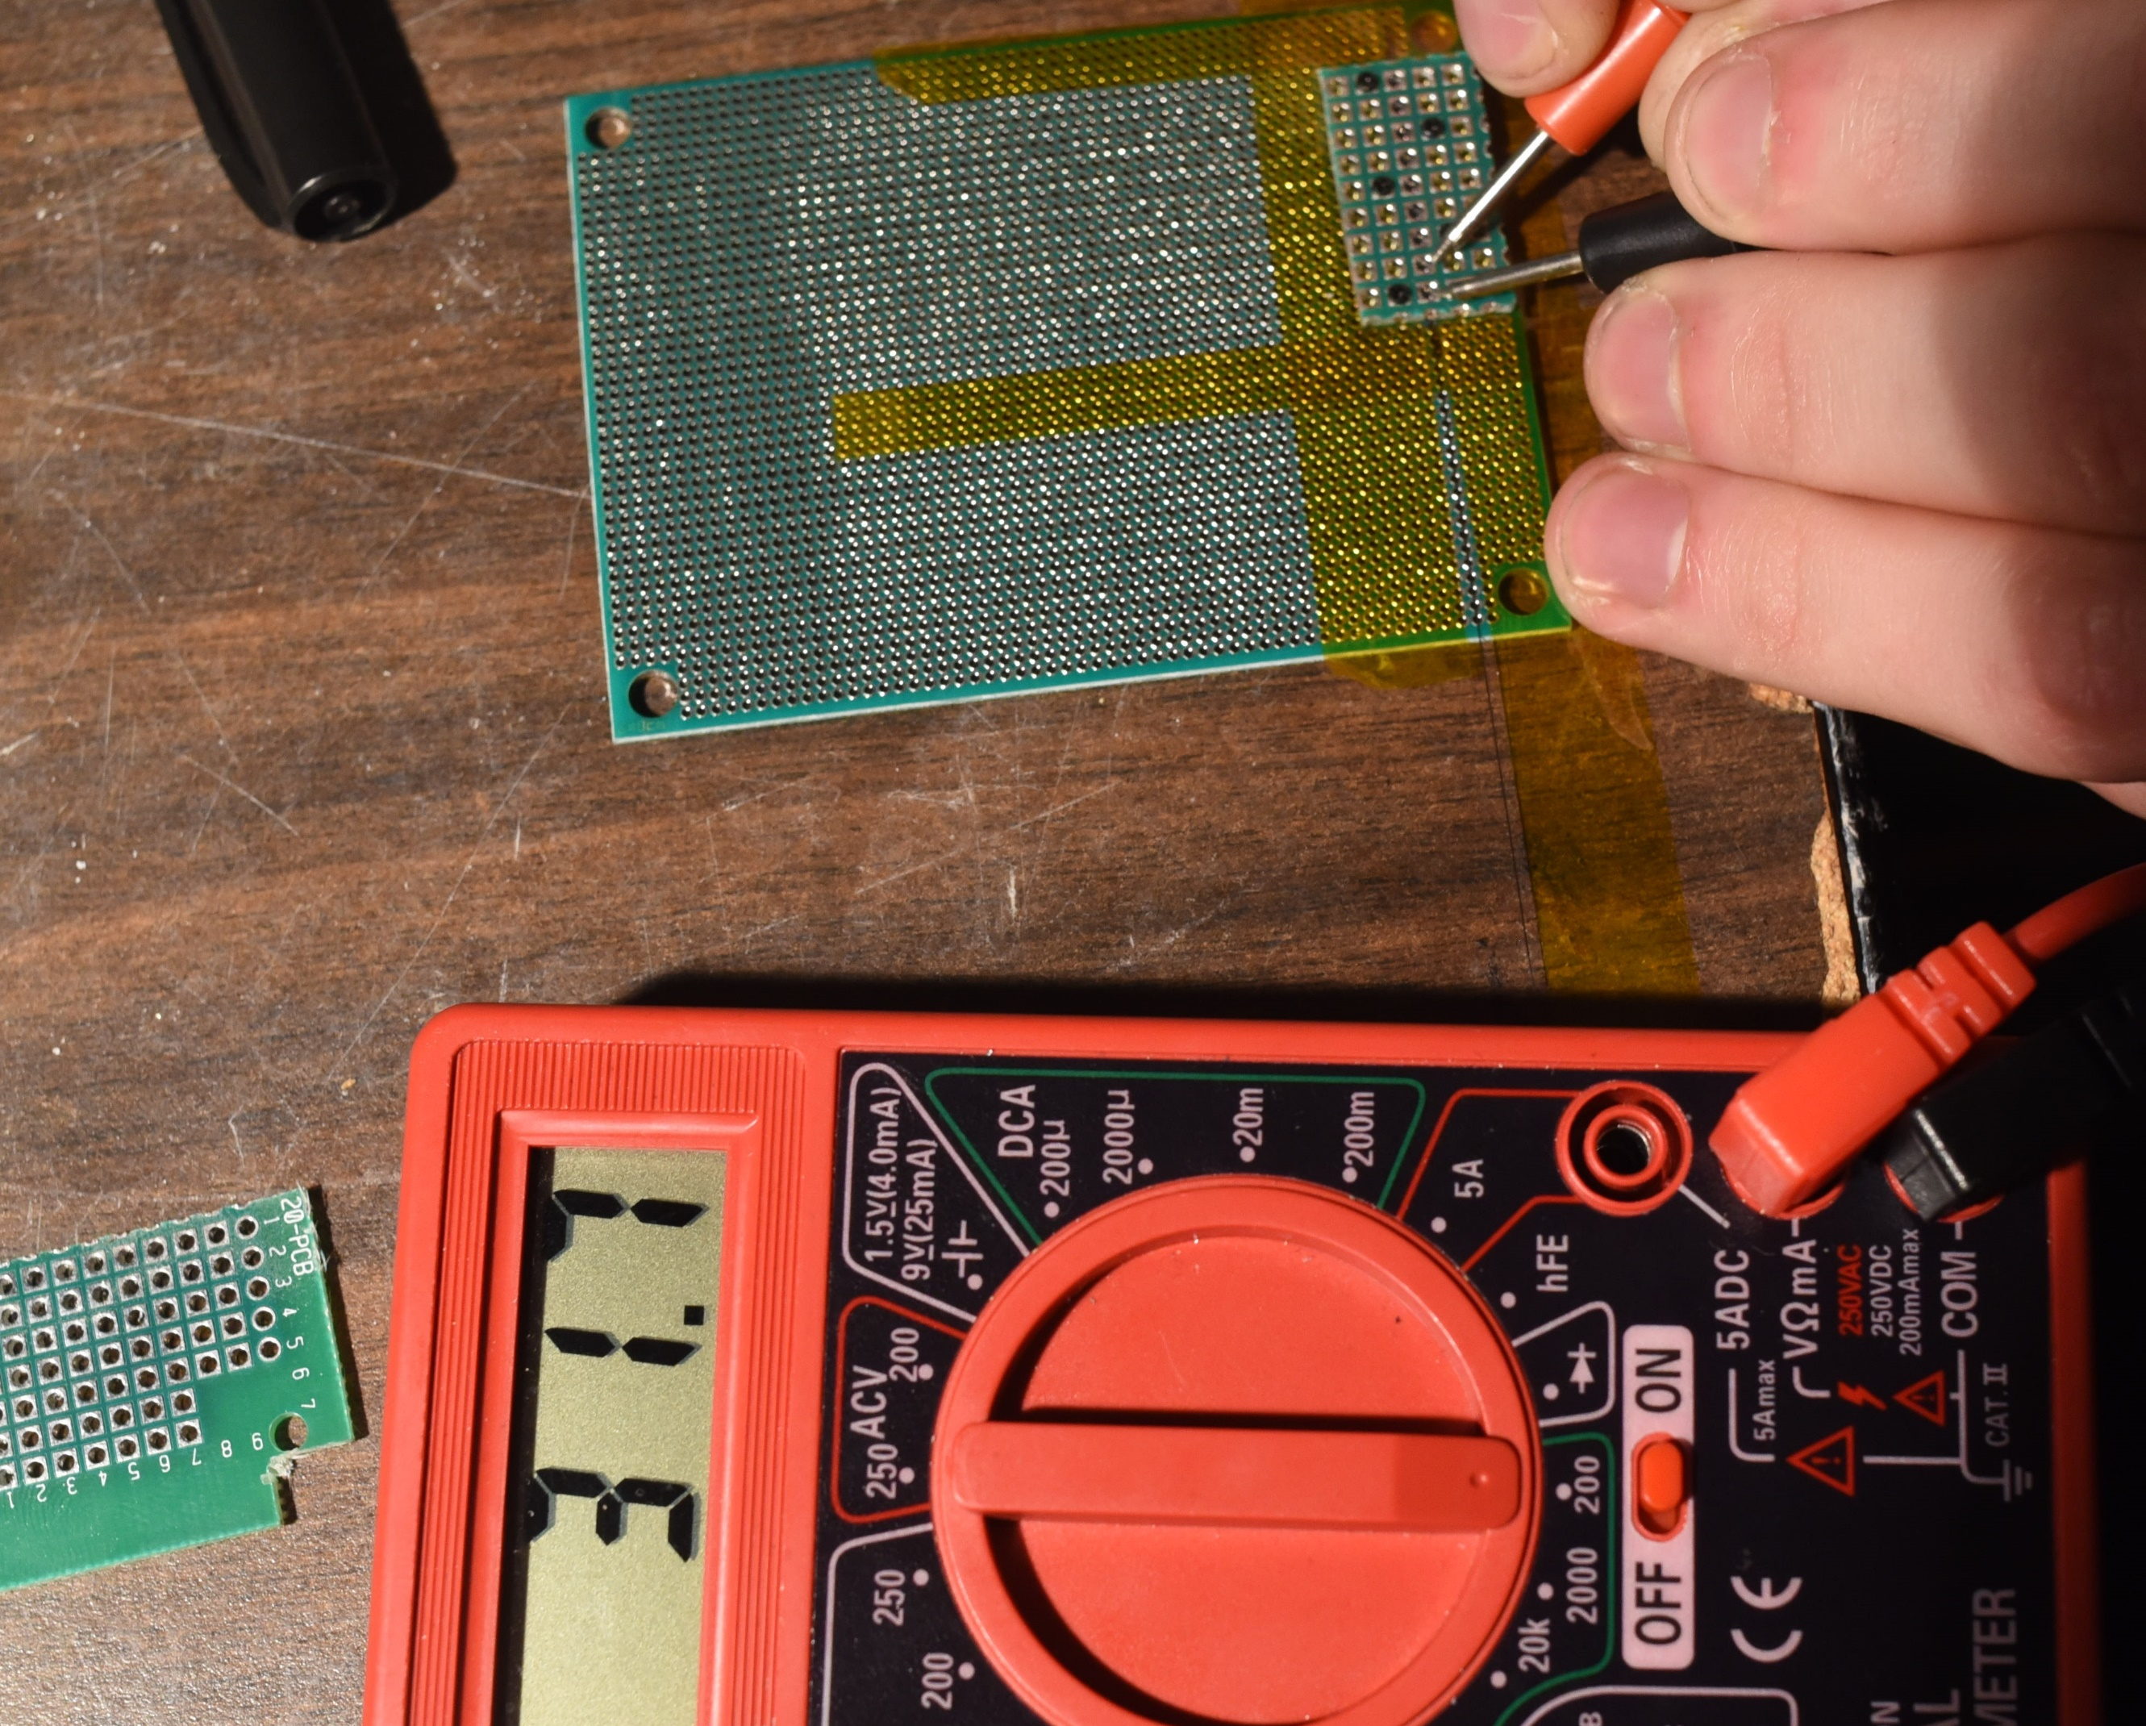
Installing the backplane
13. Set your multimeter to the 200 Ohm setting, and probe each pair of adjacent contacts along the heater row on the now secured backplane.
Go back and tighten the screws until all the heater resistances read between 10 and 100 ohms. If all your screws are tightened evenly and sufficiently, all the resistances should cluster between 20 and 50 ohms.
1.27mm perfboard for nozzle plate
2.54 mm perfboard Backplane
Multimeter probes

Slide 23
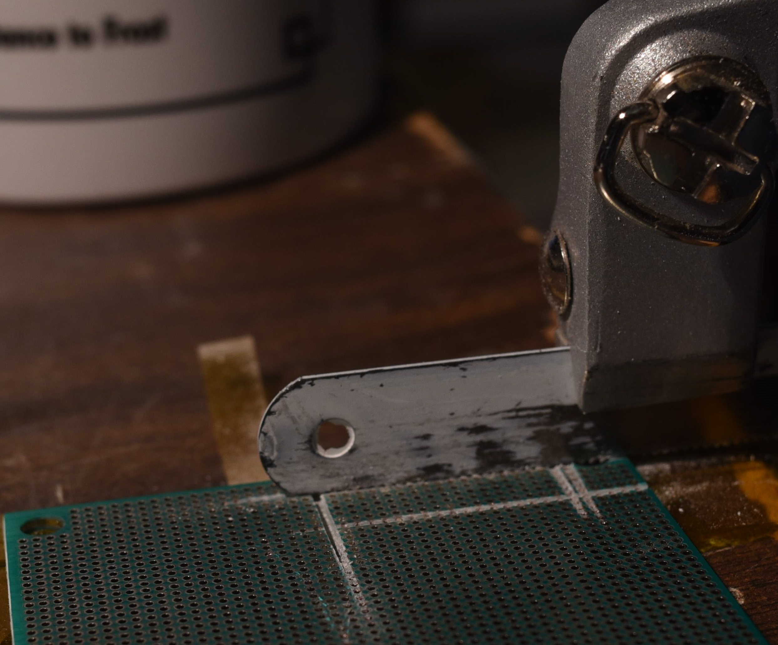
Releasing the printhead
14. You may now use your hack saw, or mill to carefully release the print head assembly from the nozzle plate stock, if you did not cut the nozzle plate out separately…
This will be done by cutting flat through the surface of the 1.27 mm perfboard stock as shown…
Hacksaw
Nozzle Plate
1.27mm perfboard for nozzle plate

Slide 24
Releasing the printhead
14. You may now use your hack saw, or mill to carefully release the print head assembly from the nozzle plate stock, if you did not cut the nozzle plate out separately…
This will be done by cutting flat through the surface of the 1.27 mm perfboard stock as shown…

Slide 25
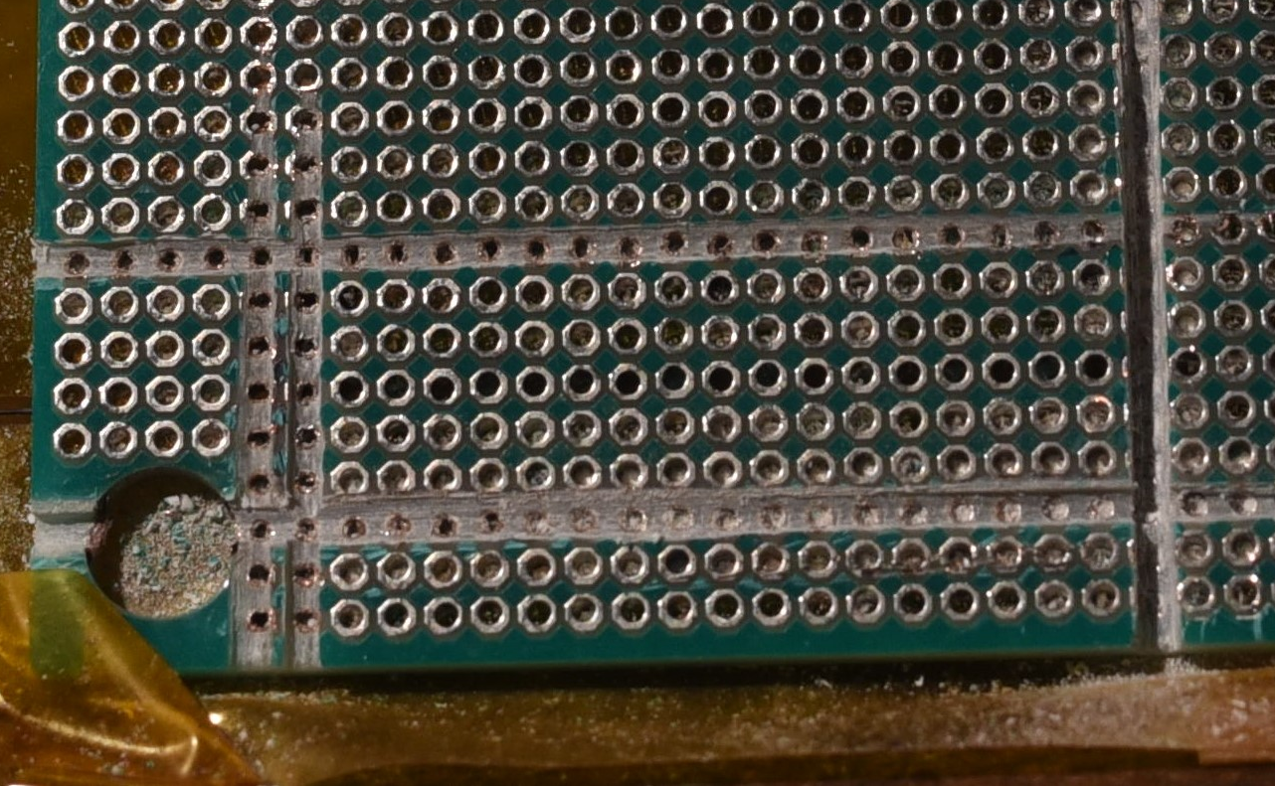
Releasing the printhead
14. Cutting through the 1.27mm perfboard is quite tough. It takes some patience and a turdy work surface. A clamp or other work piece holder can help, though it is possible to perform the release entirely by hand.
Nozzle Plate
1.27mm perfboard for nozzle plate

Slide 26
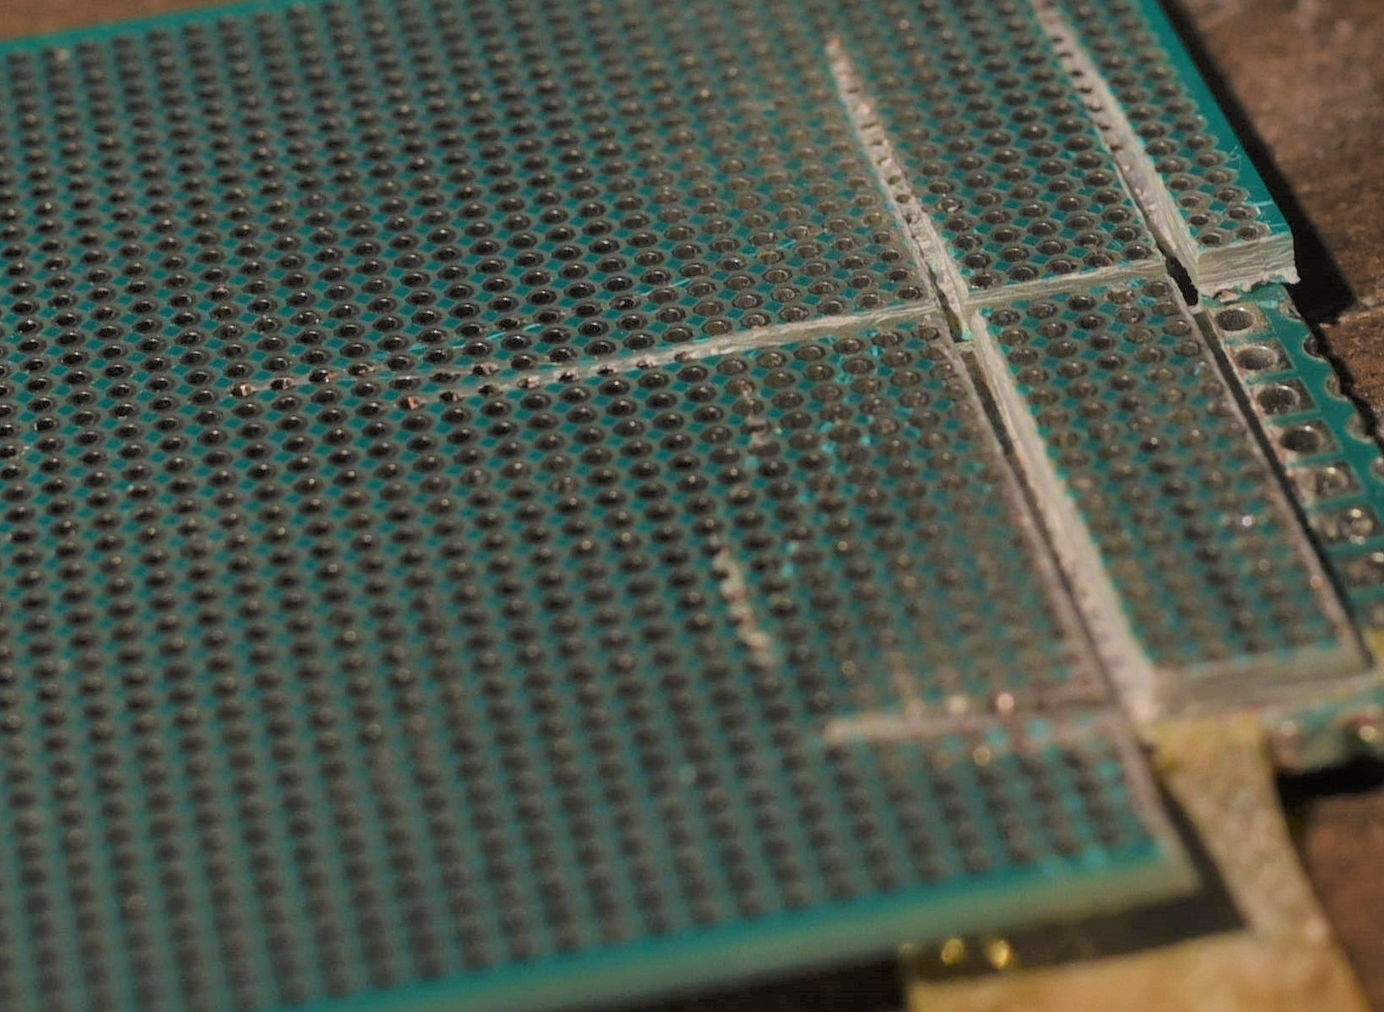
Releasing the printhead
14. You may find that pieces of the nozzle plate stock 1.27mm perfboard break off as you saw through it. Stop once you can see the 2.54 mm perfboard back plane showing. Be sure to leave the 2.54 mm perfboard excess material around the nozzle plate, to use as a flange for later.
Nozzle Plate
Back plane flange showing
1.27mm perfboard for nozzle plate

Slide 27
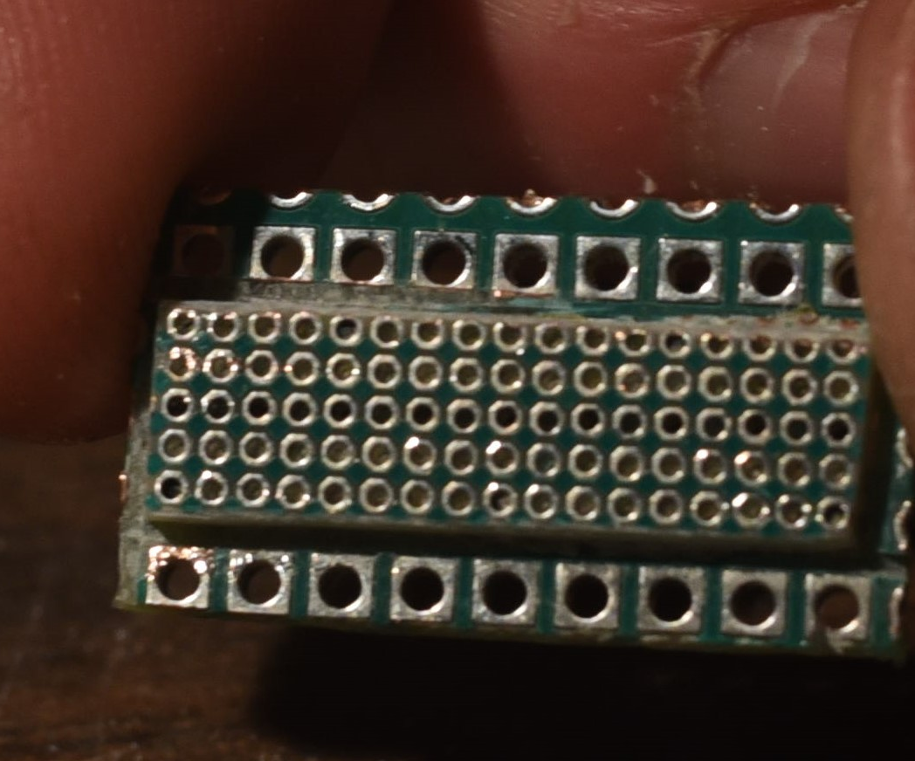
Releasing the printhead
15. After perhaps 10 minutes of steady work, you should end up with something like what you see in this image of the released print head. Each active nozzle (every other hole in the 1.27 mm perfboard nozzle plate) is ~0.635 mm in diameter and ~1.6 mm deep. Each is plated with copper and nickel which serves as a thermal barrier coating.
Back plane flange
Nozzle Plate
Active Nozzles

Slide 28
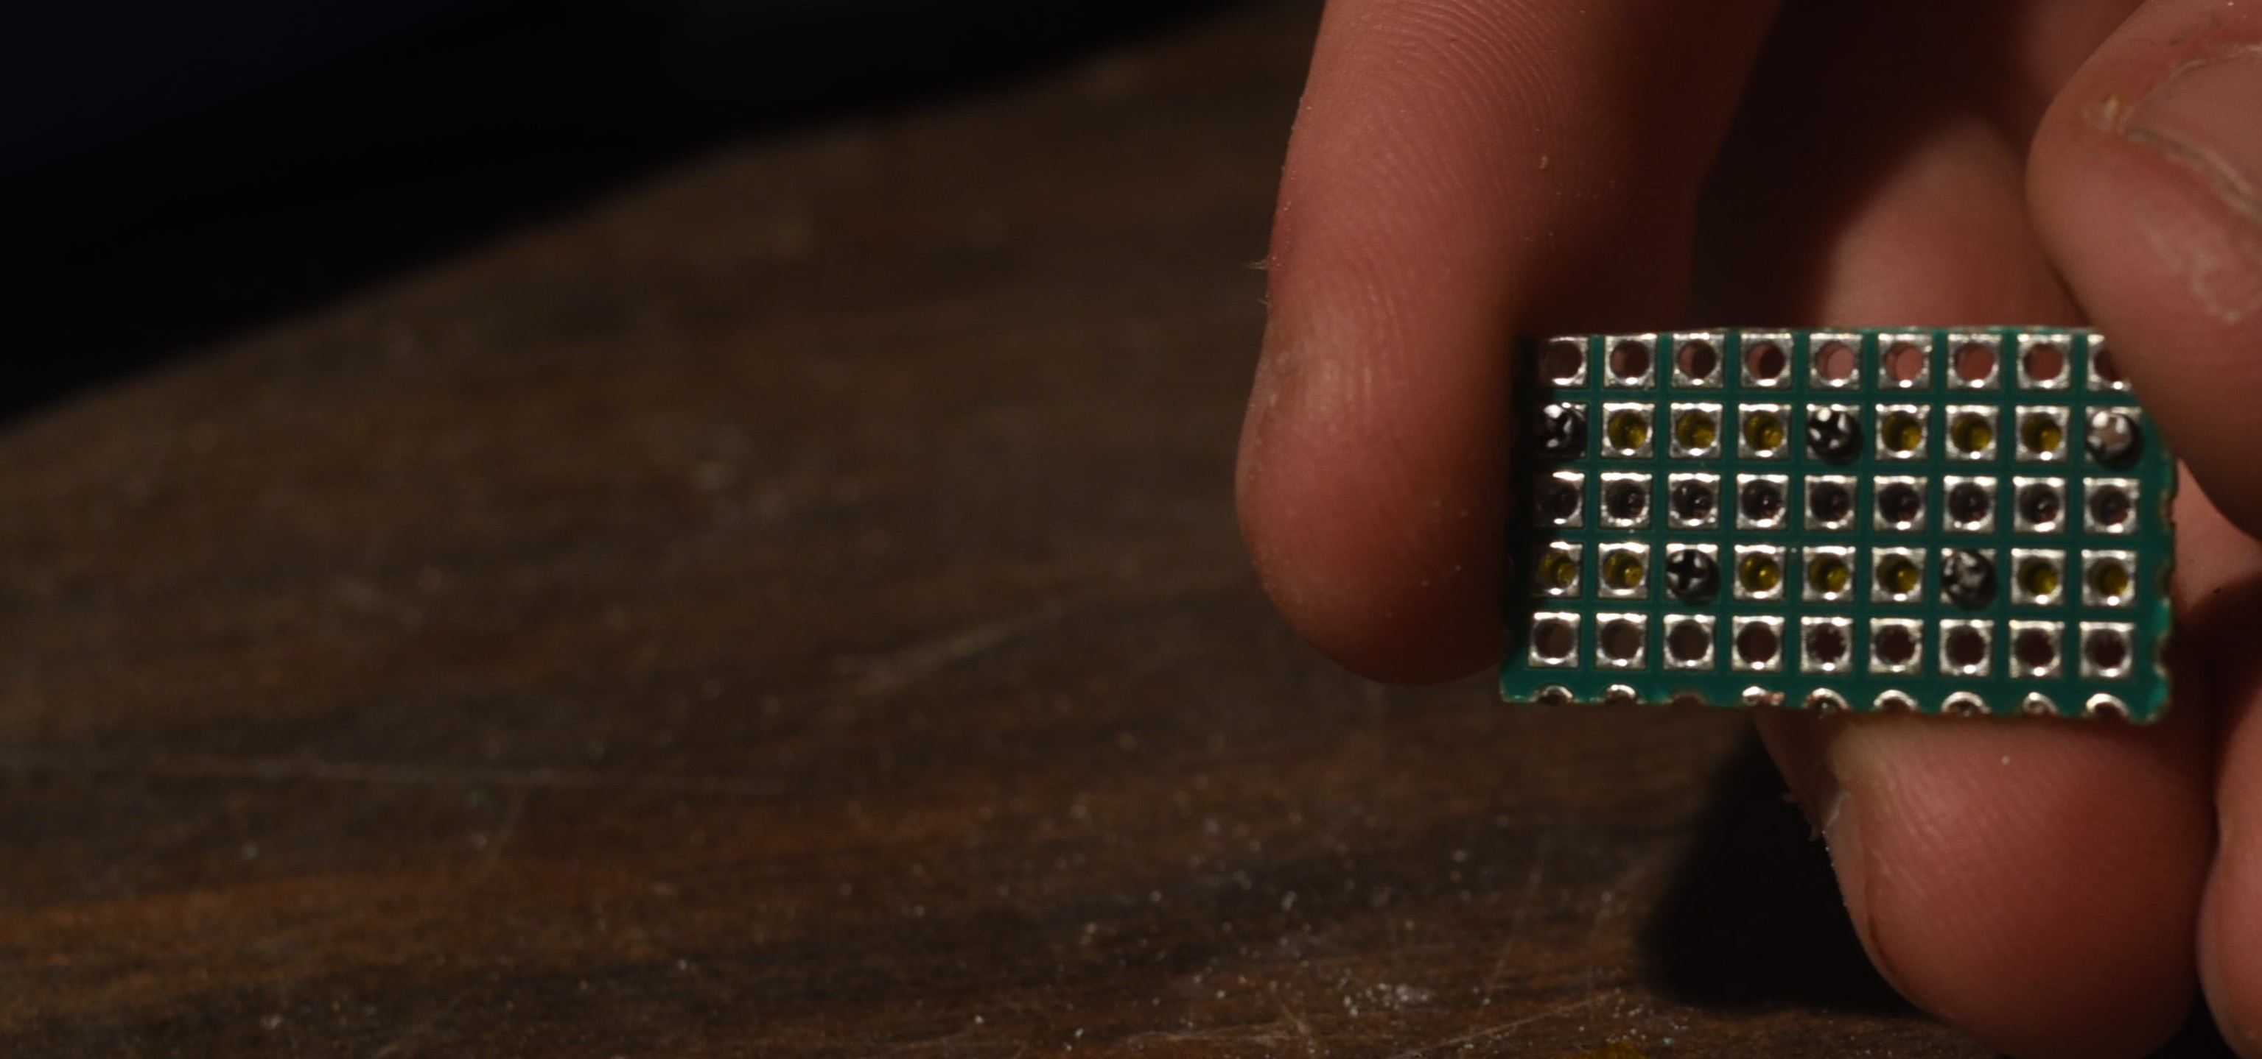
Releasing the printhead
15. Take note of the heater and nozzle locations. Each heater formed by the contacts of the 2.54 mm pitch perfboard pressing against the silicon carbide monofilament, create heaters that are cylindrical and have dimensions of ~0.5mm long X 0.135mm diameter.
Back plane
Fastening screw
Heater Locations

Slide 29
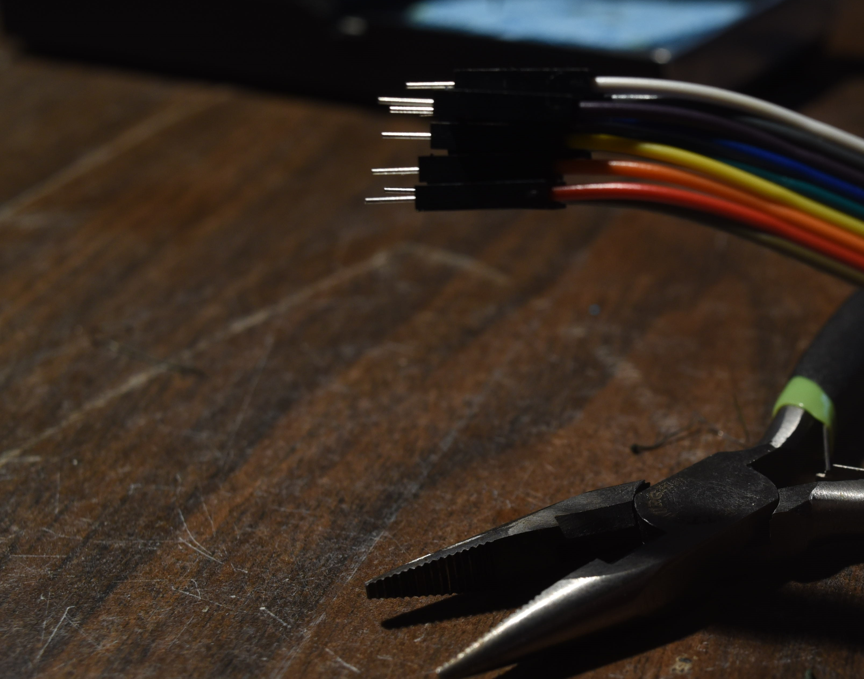
Packaging and Back Contacts
16. Once you have your completed print head chip, and have identified the back contact locations, grab a set of 9, separately colored 0.1” jumper pins, and leave them glued together to make a homemade color coded ribbon cable.
9, 0.1” jumpers
Leave together to make ribbon cable
Needle Nose pliers for next step…

Slide 30
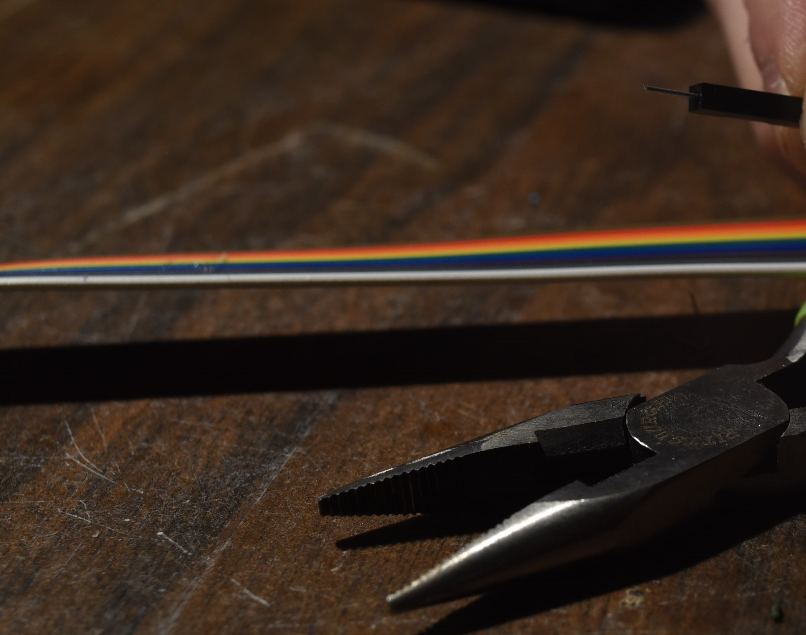
Packaging and Back Contacts
17. Use a pair of needle nose pliers to bend the pins, at one end of your “ribbon cable” to 90 degree “L” shapes.
Unbent Jumper
Leave together to make ribbon cable
Needle Nose pliers for bending jumper

Slide 31
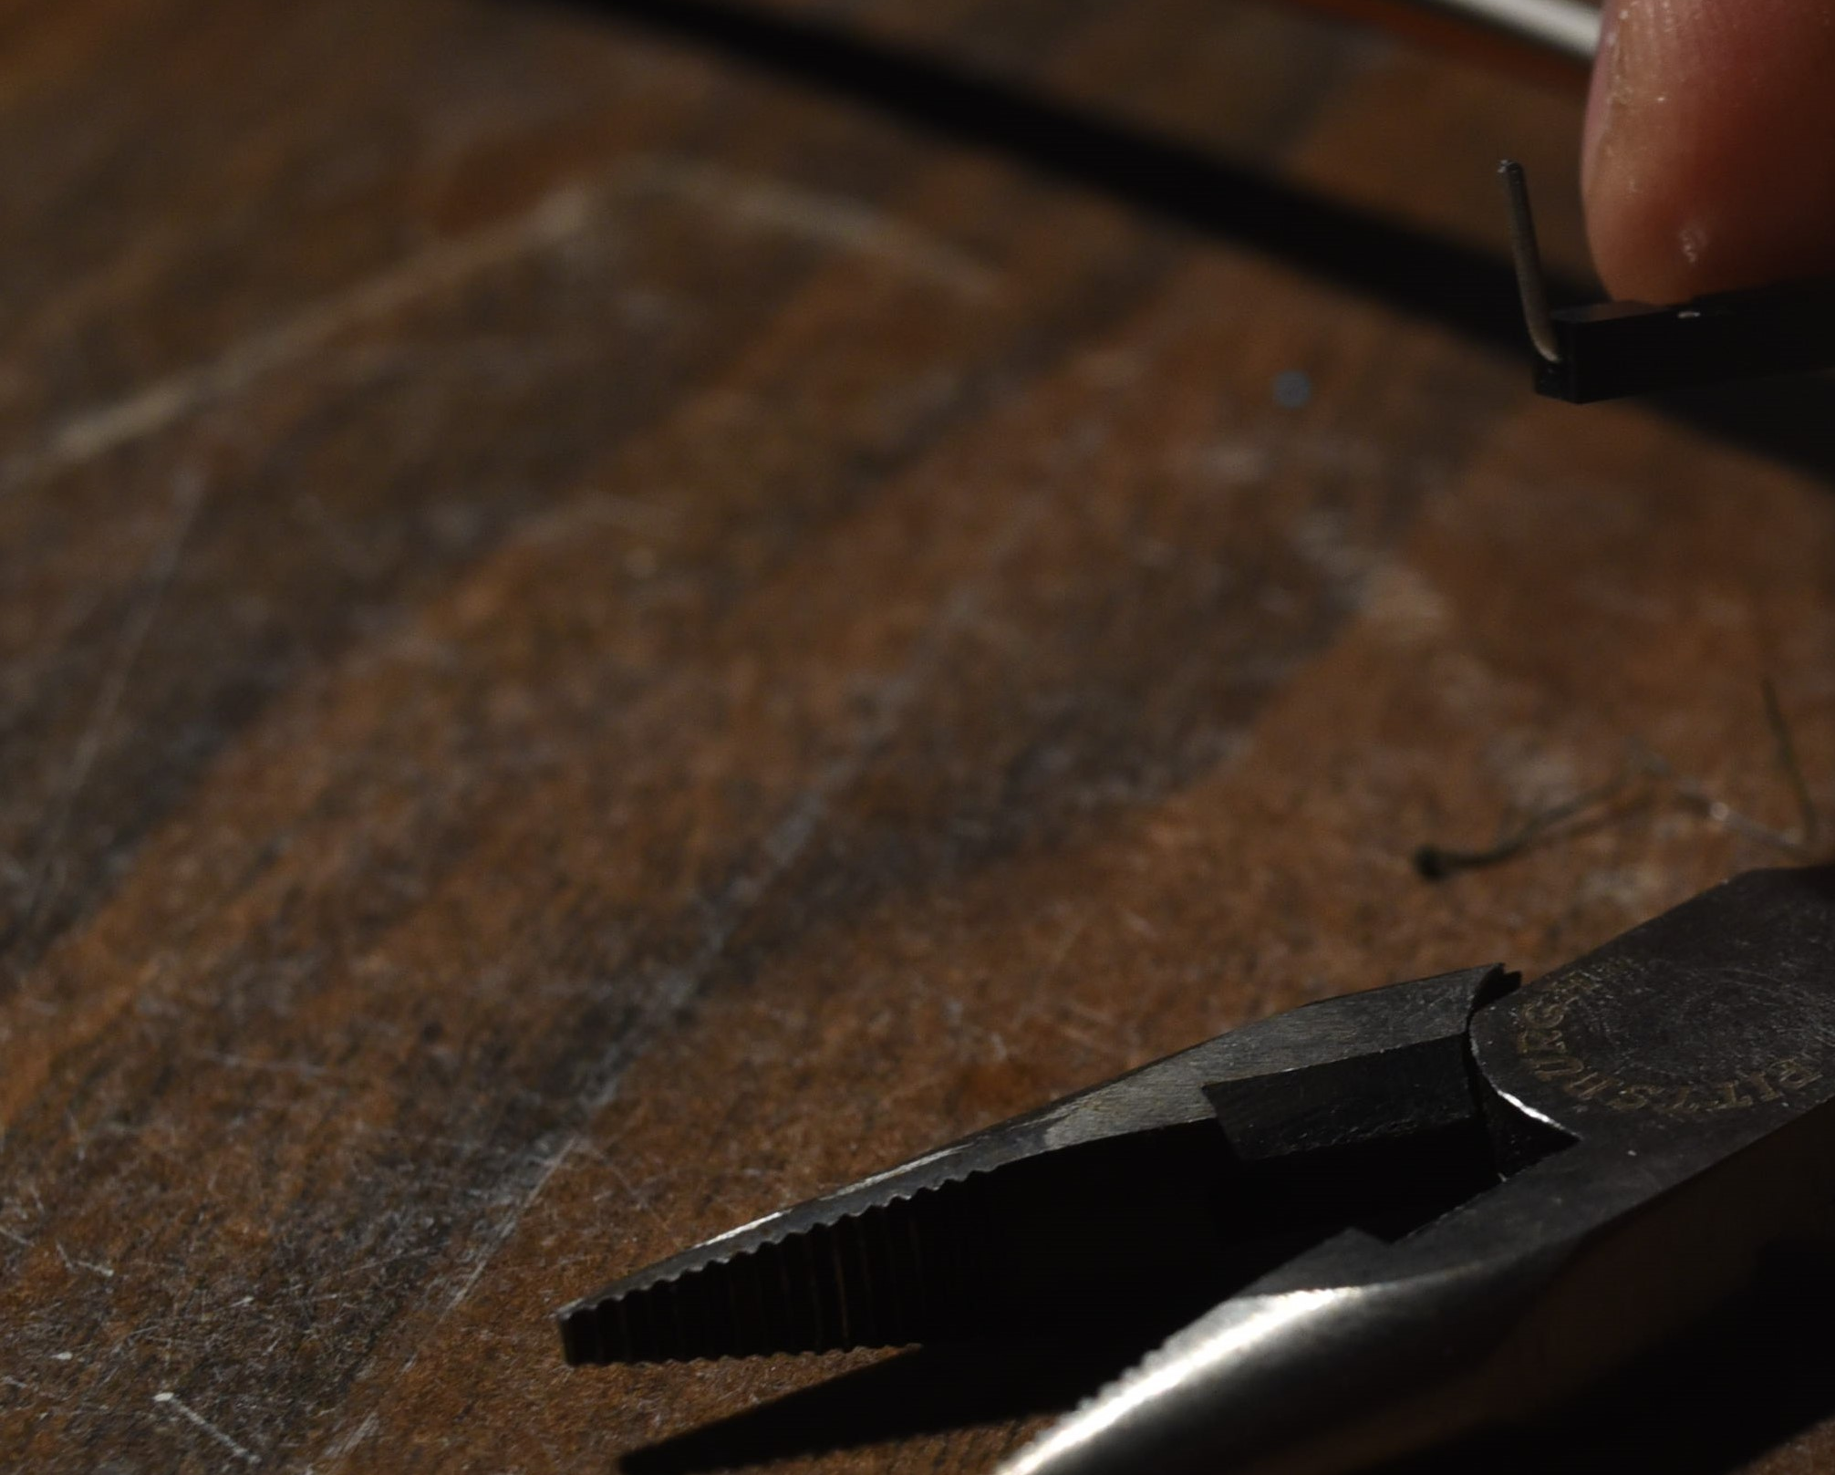
Packaging and Back Contacts
17. Use a pair of needle nose pliers to bend the pins, at one end of your “ribbon cable” to 90 degree “L” shapes.
Bent Jumper
Needle Nose pliers for bending jumper

Slide 32
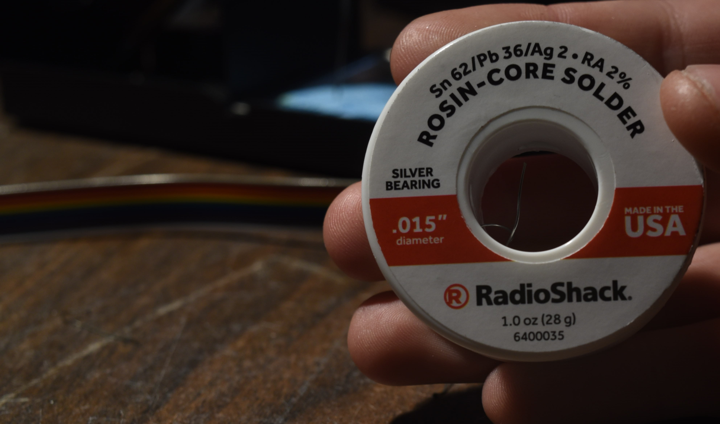
Packaging and Back Contacts
18. Solder the freshly bent “L” shaped jumper pin ends of the ribbon cable to the back contacts (the 2.54mm pitch perfboard plated holes we identified earlier in slide 27 and 28). This could take some time, it is a tight job, and can be frustrating. Take your time, take breaks and try not to breath too much solder. A fine tip soldering iron, and some fine solder wire helps.

Slide 33
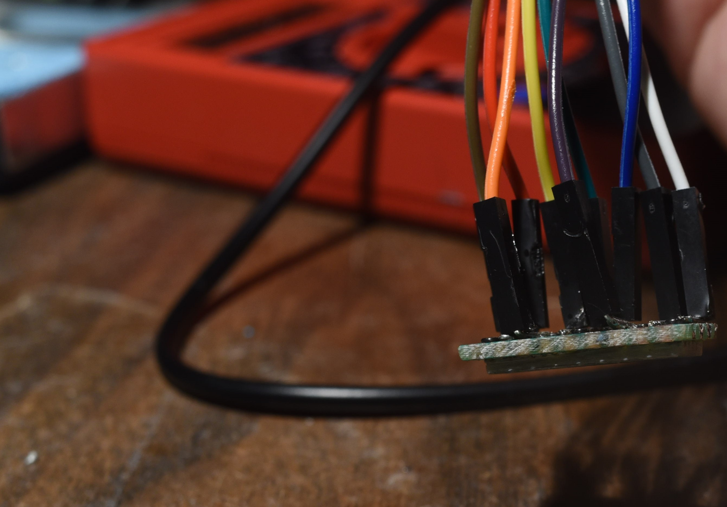
Packaging and Back Contacts
19. When finished your jumpers should have their insulated black thermoplastic end covers inside the perimeter of the print head back plane. Like the image to the right otherwise it may not fit into the reservoir and package very well…
To rest of ribbon cable to controller + power
Bent Jumper
2.54mm pitch backplane
1.27mm pitch nozzle plate

Slide 34
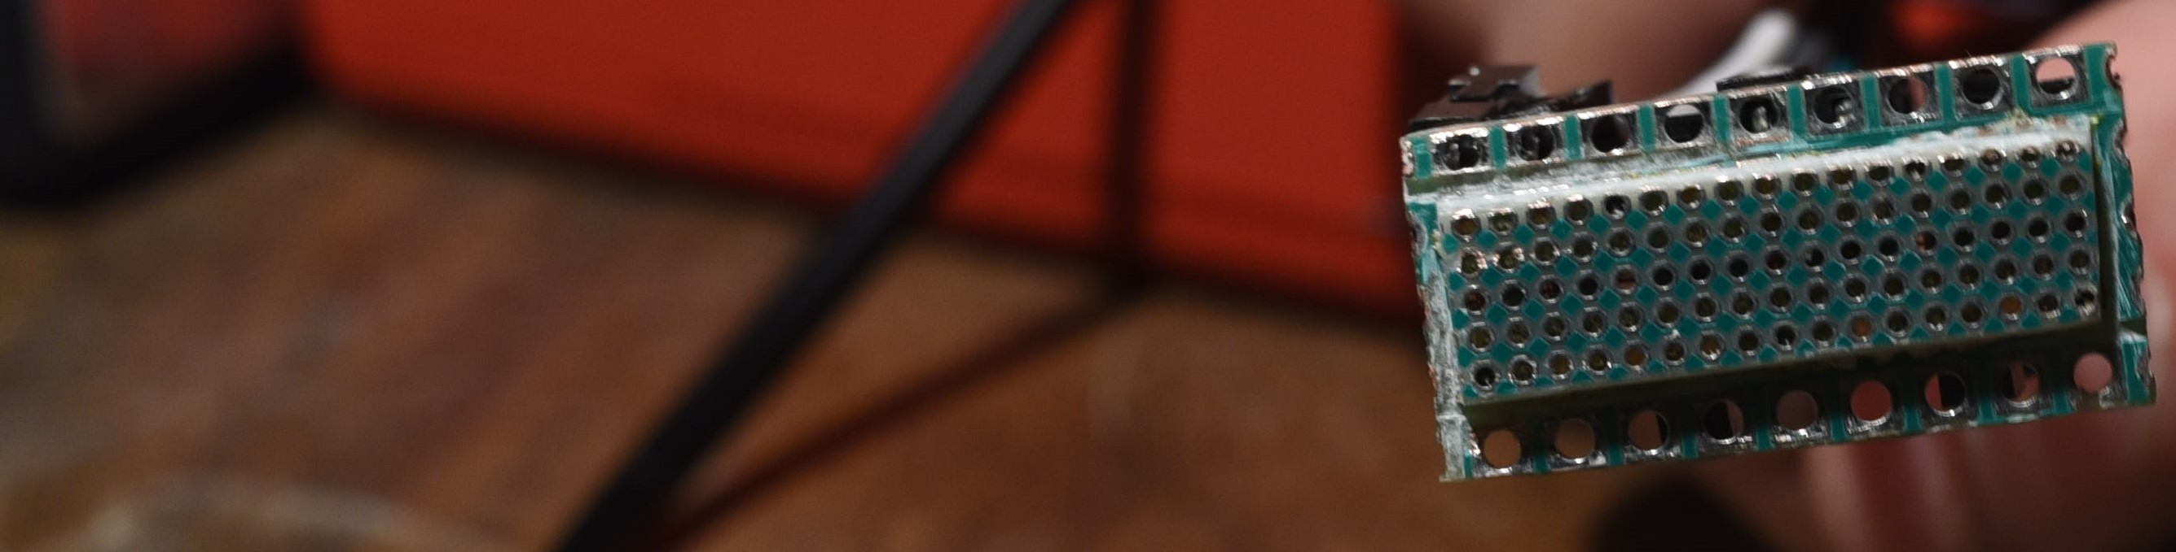
Packaging and Back Contacts
Flange to coat in glue in next step…
19. When finished your jumpers should have their insulated black thermoplastic end covers inside the perimeter of the print head back plane. Like the image to the right otherwise it may not fit into the reservoir and package very well…
Jumpers within the edges of the backplane
1.27mm pitch nozzle plate
2.54mm pitch backplane

Slide 35
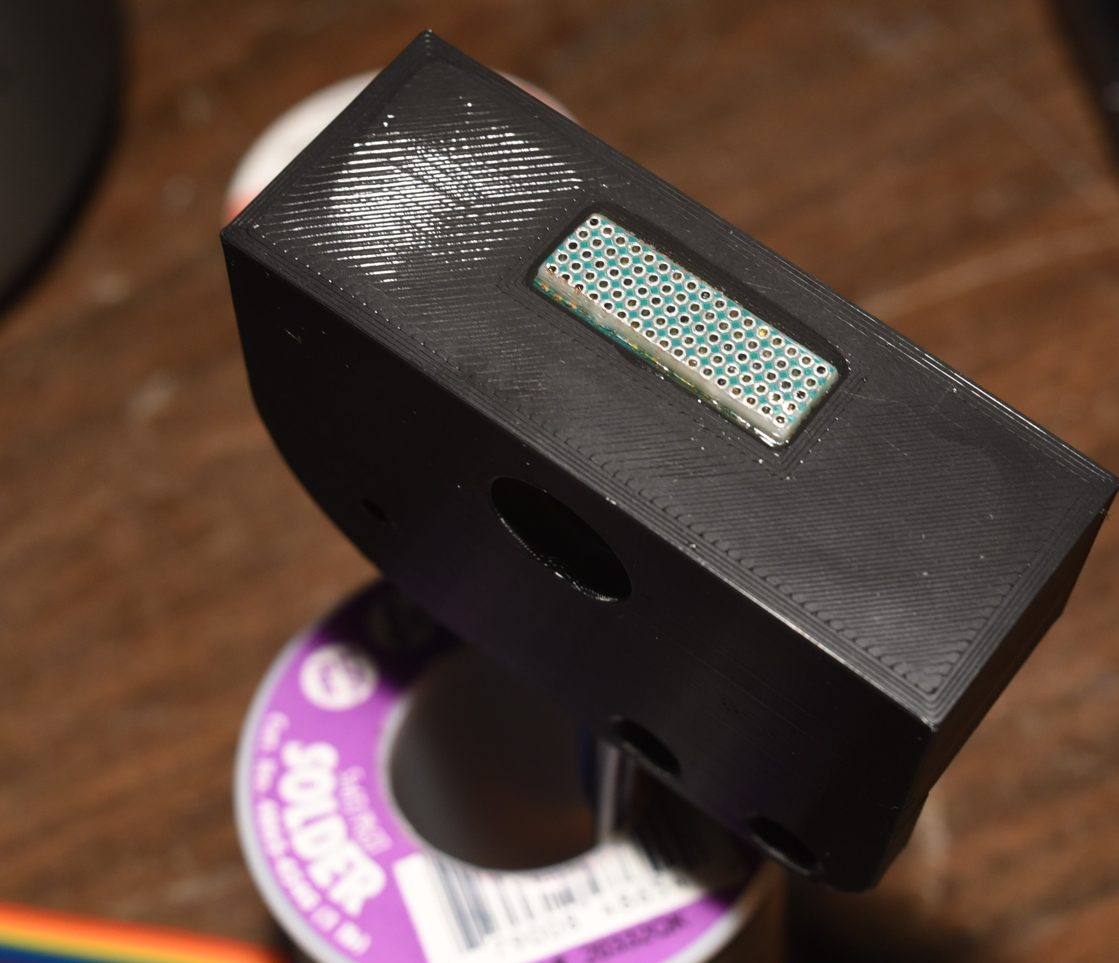
Packaging and Back Contacts
20. The last step is to coat the edges of the print head chip in a two part epoxy or superglue, and press it into the hole in the bottom of the 3D printed reservoir and creality ender 3 compatible package. Be careful not to get the epoxy up onto the nozzle plate, and try to keep it on the flange of the backplane as much as possible.
Clear Gorilla Epoxy bead
Nozzle plate
PLA+ FDM prined reservoir
Solder roll used as curing jig

